Slide 1
Foresight Synergy Network (FSN) seminar – 9th march 2021
“We should trust Artificial Intelligent (AI) to make moral decisions under certain preconditions”
A foresight view on
Artificial Intelligent Systems of tomorrow
By Richard Viger ©

Slide 2
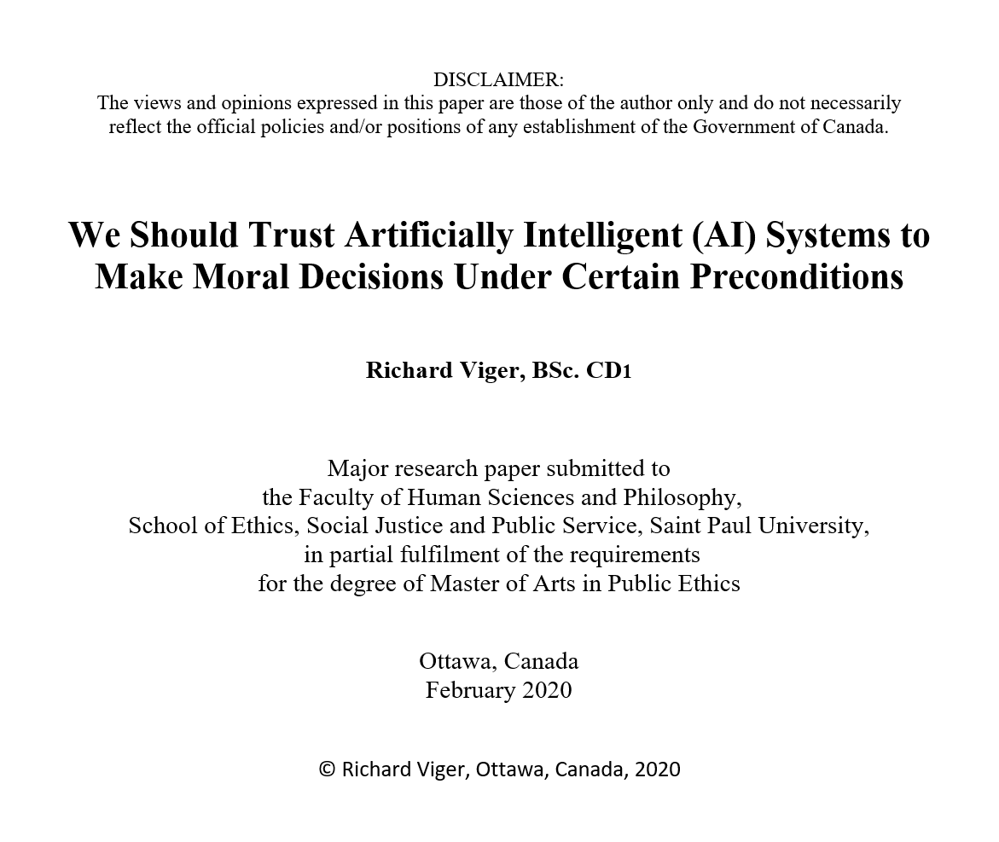
PRESENTATION IS BASED ON

Slide 3
Outline
Introduction to Some Contemporary Technological Issues (Experience) as per Bernard Lonergan’s Generalized Empirical Method (GEM)
Artificial Intelligence and the Promise of Science (Understanding)
Moral Human Cognition (Understanding)
Further Analysis (Judging)
Conclusions & Recommendations for Future Work (Acting)

Slide 4
1. Introduction to Some Contemporary Technological Issues (Experience)
AI can be expected to go beyond “narrow AI”
A Selected Literature Review
Unresolved Modern Ethical and Moral Issues
More on the Thesis Statement

Slide 5
AI can be expected to go beyond “narrow AI”
Modern technological societies face many challenges that require state-of-the-art support systems for making informed and responsible decisions.
In a world where information resources are widespread, people have greater access to massive amounts of data, which can be overwhelming.
At some point, managing all related personal and social data elements and information will go beyond human cognition. Many intelligent assistants (e.g. Apple’s Siri, Amazon Alexa, Google Assistant, MS Cortana, etc.) are needed more then ever.
We seem to have already gone beyond human cognition in many sectors.
It is imperative to note that although Machine Learning (ML) is used by many AI systems, ML is an AI subset. AI here, is a larger concept used to create intelligent machines that could in time simulate human thinking capabilities and behaviours.

Slide 6
A Selected Literature Review 1 of 4
More than ever before, AI information systems affect human activities in all areas of society. Social scientists, philosophers, and even theologians are becoming aware of the impact these new sciences and technologies are having in societies.
It is widely recognized and accepted that it is necessary to ensure that these new AI systems have to behave ethically and morally.
Recently, “speaking to executives from some of the world’s most important tech companies, Pope Francis said that technology needs ‘both theoretical and practical moral principles’, and that advances in fields such as artificial intelligence (AI) cannot lead to a new ‘form of barbarism’, where the common good is abandoned to the rule of law of the strongest” (Inés San Martín).

Slide 7
A Selected Literature Review 2 of 4
For theoretical and practical moral/ethics principles to be developed for AI, it has been proposed that a new philosophy will be needed to fit this new environment where broader hard decisions are made by machines in real-time (e.g. driverless vehicles). See MIT Internet study https://www.moralmachine.net/ 40+ million votes
Dr. Luciano Floridi is proposing that the new philosophy of information (PI) will help humanity in developing, evaluating, monitoring, and managing these smart AI systems and Information and Communications Technologies (ICTs). His “research areas are the philosophy of information (PI), information and computer ethics, and the philosophy of technology” (University of Oxford).

Slide 8
A Selected Literature Review 3 of 4
A recent paper, “Leadership in a post-truth era: A new narrative disorder” confirms that social changes based on emotions (e.g. individual rights and associations), rather than discussing broader social values, will challenge the evolution of socially-responsible AI due to a lack of political leadership (Foroughi, Gabriel and Fotaki 135).
Another philosopher who had been bridging social issues with ICTs was Hans Jonas (“Technology and Responsibility”1973).
Jonas’ view was that traditional ethics is not able to deal with ethical and moral issues related to the contemporary global technological civilization. He argued that we need a new kind of ethics, which he termed an “ethics of responsibility” (Winston and Edelbach 116).

Slide 9
A Selected Literature Review 4 of 4
Jonas believes that any ICT system taking action must do so morally, writing that “if the realm of making has invaded the space of essential action, then morality must invade the realm of making” (Jonas 42). For Jonas, rational beings can only will truth and truthfulness. This is very much a Kantian view of rational beings. Jonas also believes that to be justly accountable (i.e., responsible), one must also be truthful. We will need to build a sense of responsibility into AI systems’ decisions. Jonas did not argue for a specific new ethics; he just asserted that it was needed.
We, as a society, are morally responsible to ensure we build and use moral/ethical systems/machines. Guidelines, policies, and laws will be needed. See Germany’s laws by Federal Ministry of Transport and Digital Infrastructure.
Ethics refers to “the discipline dealing with what is good and bad and with moral duty and obligation, [and/or] a set of moral principles; a theory or system of moral values” (Merriam-Webster). The level of agency of an AI system is key.

Slide 10
Unresolved Modern Ethical and Moral Issues 1 of 5
Jonas (Jonas 178) states that religion alone is no longer guiding us in a modern technological world and that current human philosophy is not adapted to a world where actions are not only between two individuals directly, but also conducted through a number of interactions and actors, where direct accountability between the actor and the person receiving the consequences of an act is no longer clear.
So what to do?
In a world where extensive ICT systems create novel power to act on several individuals in various times and spaces simultaneously, where even automated agents have the power to act, the definition of the relationship between ICTs and humans changes.
If a system has agency, then it must have a built-in moral compass!

Slide 11
Unresolved Modern Ethical and Moral Issues 2 of 5
Societies will have to be able to create new policies to regulate a just, safe, and free world for its citizens. Others might decide to do otherwise. At the International level, who will ensure that new technologies (e.g., AI) are used responsively with respect to National, local, and individual sovereignty?
Jonas does not argue for a specific new ethics; he just asserts that it is needed. Looking at the existing literature, we are not aware of any new form of satisfactory universal ethics able to address concerns about the new challenges that we face as a technological society, such as human interactions with artificial intelligent agents with a level of agency that is outside the immediate control of humans.
What form of ethics should AI agents use? Currently, many groups from many countries have looked at AI and ethics. Many have identified their own lists of principles for the safe development and use of AI, but there is no standard agreement on what that should be. In which “mode” do you want your Tesla?

Slide 12
Unresolved Modern Ethical and Moral Issues 3 of 5
A recent academic document provides a very comprehensive look at what has been done on the subject of AI ethics. Dr. Thilo Hagendorff’s report, “The Ethics of AI Ethics -- An Evaluation of Guidelines”, compares AI ethics guidelines used around the world. Dr. Hagendorff has identified some significant omissions between the various guidelines, which could have serious ethical effects on the citizens operating under these “local” guidelines and principles (Hagendorff 67).
That is concerning, not only for the “local” citizens, but also for the rest of humanity, given that products and services no longer have geographical boundaries.
In addition, Dr. Hagendorff has united with seven other authors to publish a report called “Artificial Intelligence Governance and Ethics: Global Perspectives”. Yes, it is a global issue!
We propose that we can learn how humans come to reach morally superior decisions. In learning from the human cognition, we will look at the methods Bernard Lonergan created to get an insight on how to make good decisions. The aim is to build these methods into AI.

Slide 13
Unresolved Modern Ethical and Moral Issues 4 of 5
In the realm of current AI development, there is a document, “Artificial Morality: Top-down, Bottom-up, and Hybrid Approaches”. The authors suggest that the idea of building “artificial morality” as a way to provide AI with a sense of right and wrong, is a worthy and necessary endeavour (Allen, Wallach and Smit).
EXTRACT: The implementation of moral decision-making abilities in AI is a natural and necessary extension to the social mechanisms of autonomous software agents and robots. Engineers exploring design strategies for systems sensitive to moral considerations in their choices and actions will need to determine what role ethical theory should play in deﬁning control architectures for such systems. The architectures for morally intelligent agents fall within two broad approaches: the top-down imposition of ethical theories, and the bottom-up building of systems that aim at speciﬁed goals or standards which may or may not be speciﬁed in explicitly theoretical terms.… A principal goal of the discipline of artificial morality is to design artificial agents to act as if they are moral agents. Intermediate goals of artificial morality are directed at building into AI systems sensitivity to new and/or old values, ethics, and legality of activities as we explore future solutions that are acceptable. (Allen, Wallach and Smit 149) Building artificial morality is making a system of systems (an architecture)

Slide 14
Unresolved Modern Ethical and Moral Issues 5 of 5
Ref: https://www.canada.ca/en/government/system/digital-government/digital-government-innovations/responsible-use-ai.html
The Government of Canada website, “Responsible Use of Artificial Intelligence (AI)” talks about the need for values, ethics, and legal capacities to be built-in before any AI is permitted to be deployed and interact with humans in various capacities on Canadian websites.
Here is an extract describing what is intended: “Artificial intelligence (AI) technologies offer promise for improving how the Government of Canada serves Canadians. As we explore the use of AI in government programs and services, we are ensuring it is governed by clear values, ethics, and laws” (Government of Canada).
Little is provided, however, in terms of clear values, ethics, and laws for AI systems
also being used in industry, academia, and by other nations and levels of governments

Slide 15
More on the Thesis Statement
“we should trust artificially intelligent (AI) systems to make moral decisions under certain preconditions.”
Trust means “assured reliance on the character, ability, strength… one in which confidence is placed in someone or something” (Merriam-Webster).
As the rhyming Russian proverb says, “trust but verify”, we will see how important the capability to monitor and verify the performance of AI systems will become, if we are to entrust them at a level of agency that could have consequences for humans.
Can we build trust between humans and AI systems? Can an AI system develop a persona? Personal assistants seems to be able to do so to a level.
Higher level of trust will be needed for potentially higher consequences to humans. 3rd party certifications might be needed, like what is done in safety-critical systems, which undergo very strict and well control testing.

Slide 16
2. Artificial Intelligence and the Promise of Science (Understanding)
Further Unpacking the Thesis Statement
A New Technological Living Environment is Emerging
Going Fully Digital Creates Big Data, Which Calls for Even More AI
New Emerging Social Demands for AI
How the Philosophy of Information Impacts Our Understanding

Slide 17
Further Unpacking the Thesis Statement 1 of 2
Perhaps one could say that the emergence of AI is linked to the emergence of the problems that we face as a society today. The thesis statement is perhaps inevitable. We, as a society, must find ways to live with and be able to trust AI systems to make moral decisions on their own, because there will be too many decisions for humans to deal with in real-time. It is an invention that is right for the time we are in.
We will argue that if AI systems are here to stay, it would be irresponsible to think that we do not need to be concerned about their safe and responsible development for them to better serve humanity. The principle of having preconditions would guide us.

Slide 18
Further Unpacking the Thesis Statement 2 of 2
Beyond considering the possibility that cyber systems could be intelligent enough to make moral decisions, we need to agree, at the human level, on the value of making “good” moral decisions. The question of defining the “good” has divided philosophers of various creeds virtually forever and it is not going to change. Fundamentally, philosophers Kant and Mill would have not agreed on the definition of the “good”.
One could say that Kant wants what is “right” while Mill wants what is “good”. AI systems could learn what is “good” (by estimating and evaluating), but not initially answer the much harder question of what is “right”. That practical utilitarian view may still be sufficient for humans to be able to trust AI systems at an initial level of advice and decisions. Lonergan was a very practical and applied philosopher, so looking at his methods will help.

Slide 19
A New Technological Living Environment is Emerging
Over the past decade or so, science and technology have enabled the development of stronger AI capabilities in all spheres of life. The convergence of the increasing computational power at reduced operating size and costs, as well as increasing memory and network capacities, has enabled a new industrial digital revolution with great social impacts.
It is with these reflections that we would like to say that artificial intelligence is here for good and that we must take care of it before it takes us into an ill-conceived definition of care for humanity.
Just as the new philosophy of information has reached the hour of its birth, we inevitably will live in the period where intelligent machines and information systems are increasingly linked to the human experience.

Slide 20
Going Fully Digital Creates Big Data, Which Calls for Even More AI 1 of 3
Human beings will need to learn to collaborate better and be aware of the moral challenges that AI creates with information, knowledge, and reality, even in the media (fake news/accounts, bots, etc.). Everyone’s confidence in what we all see, read, and hear is quickly eroding. AI systems, in augmented reality environments, will likely be able to deceive our senses and our perceptions of reality with latencies of a millisecond. AI systems online or in devices are placed between us and the real world. These AI “filter” our perception by making it either better (e.g., seeing infrared images), or worse (e.g. by changing the voice and look of a person to another one in real-time).
Floridi speaks of the de-physicalization of nature and physical reality as “art, goods, entertainment, news, work, and other Selves are placed and experienced behind a glass”.
All these possible scenarios above, and more, will call for more AI capabilities to detect, correct, augment, and defend against rogue AI systems. We as humans, must be aware of and manage how the technology will evolve to better serve humanity and not let it enslave us.

Slide 21
Going Fully Digital Creates Big Data, Which Calls for Even More AI 2 of 3
The development of digital technology, as Floridi suggests, is adding more chapters to the book of nature. Therefore, the infosphere is adding and even wrapping the book of nature into a new digital format space. The infosphere may be defined as the ensemble of “communications, electronic communication and networking as a whole” (Collins English Dictionary – Complete and Unabridged).
Enveloping the world is what is done when designing a robot to paint a car in a factory. The car parts to be painted are “enveloped” by the robot environment so they can be painted. The world in which we now live in is being enveloped by all the pervasive digital technologies that are around us. The digital and human boundaries are blurring (e.g. mobile phone, internet access, Fitbits, wearables, virtual or augmented reality devices, the Internet of Things, street video monitors, etc.). If the invading boundaries are not controlled, they may become uncomfortably close, perhaps too close for some individuals. This would be especially true in places that are using technologies to monitor and control people. The concept of AI on AI would be required as a defence.

Slide 22
Going Fully Digital Creates Big Data, Which Calls for Even More AI 3 of 3
This inevitable approach of using AI raises many new ethical issues. Floridi believes that we are now living in a post-Westphalian world, where the traditional geopolitical boundaries that clearly defined a state’s sovereignty are no longer present in the world of the infosphere where everything and anyone is interconnected and recorded and the emergence of non-state and various cyber actors has aggravated this even further. Note: Westphalia (i.e. Westphalian state system): Term used in international relations, supposedly arising from the Treaties of Westphalia in 1648 which ended the Thirty Years War.
In this growing world of the infosphere where there are no boundaries, there are traditional conflicting requirements that are now expanding rapidly. For example, the conflict between the need for public and private spheres, or security and privacy where states are trying to reach a compromise, is not reconcilable and cannot please all interests. Societies are facing many new legal and ethical challenges about data sovereignty at the International, National, local (e.g., smart cities), individual levels including commercial Intellectual Property (IP).
Some see AI as a way to monitor, detect, analyze, and mitigate the issues in the infosphere with speed.

Slide 23
New Emerging Social Demands for AI 1 of 3
The world has changed, so there are many jobs that no longer exist because science and technology have changed what we do fundamentally.
Professor Klaus Schwab states in his 2016 book of the same name that we are now in the Fourth Industrial Revolution. He indicates that this latest industrial revolution is all about enhancing cognitive power to augment production. We are also in the middle of an information revolution that is fueling progress toward better and stronger AI, as AI is at the centre of it all.
In April 2017, the global production of transistors surpassed 20 trillion per second. The acceleration in the growth of data is putting pressure on material physics (limits to Moore’s Law) and on storage (i.e. data is not recorded or something is being erased).
Individual and social well-being relates to Information Communications Technologies (ICTs) on which we now critically depend more than ever. In a presentation posted on YouTube, Floridi states that “those who live by the digit may die by the digit”. (Floridi 130)

Slide 24
New Emerging Social Demands for AI 2 of 3
We are now, more than ever, experiencing a cultural neo-dualism between the physical and the mental ways of doing analytical work and perceiving the world which risks dividing us profoundly if we do nothing about it.
Some who think of the world as a physical one, look at data, patterns, syntax, and quantitative manners. We could say that AI is the new modern steam engine that burns data as fuel. Others look at the world as a mental construct, which includes information, knowledge, meanings, semantics, and qualitative manners. We could say that AI is a new active member of our reality.
Floridi proposes that the digital does not describe, nor prescribe the world, but rather the digital inscribes the world. Because AI has agency, it can write new pages into the book of what happens. He points out that we should think of AI as a “reservoir of agency” that can be deployed to do tasks.
“Knowledge is not a matter of (a) discovering and describing, or (b) inventing and constructing, but of (c) designing and modeling reality, its features and behaviours into a meaningful world as we experience it (semanticization)” (Floridi 370).

Slide 25
New Emerging Social Demands for AI 3 of 3
“AI for social good: unlocking the opportunity for positive impact”
Ref: https://www.nature.com/articles/s41467-020-15871-z
Abstract:
“Advances in machine learning (ML) and artificial intelligence (AI) present an opportunity to build better tools and solutions to help address some of the world’s most pressing challenges, and deliver positive social impact in accordance with the priorities outlined in the United Nations’ 17 Sustainable Development Goals (SDGs). The AI for Social Good (AI4SG) movement aims to establish interdisciplinary partnerships centred around AI applications towards SDGs. We provide a set of guidelines for establishing successful long-term collaborations between AI researchers and application-domain experts, relate them to existing AI4SG projects and identify key opportunities for future AI applications targeted towards social good.”
Ethicists and many others are already seeing the social effects in which poorly designed AI systems have on citizens. With AI4SG, however, we can see that the demands for more ethical AI are coming from all social areas of endeavour.

Slide 26
How the Philosophy of Information (pi) could Impact Our Understanding 1 of 4
At the base of the AI revolution we have information. Information itself is being redefined into nothing less than a new philosophy in and of itself (Floridi 2011). The new philosophy of information has an impact on how we now view and understand data and information in the evolving context of science and technology.
The fundamental ethical questions of the classic framework prior smart machines with agency were based on the normal use of the word “should” in these questions (i.e., assuming free will exists). The normative direction is “who,” “what,” or “why.”
Who should I be? (e.g. happy, smart, powerful, popular, rich, prosperous) – self-poetic.
What should I do? (e.g. take all means to achieve my aim of being, regardless of others, work with others and collaborate, be more creative and innovate) – substantive.
Why should I do it? (e.g. to satisfy myself, for my family, for my friends or associates (political, economic, theological, philosophic), for humanity, for the pure progress of knowledge and science, for the environment, for God, for the consciousness of the universe) – motivational.

Slide 27
How the Philosophy of Information (pi) could Impact Our Understanding 2 of 4
In the case of an intelligent machine operating in real-time and in real space, the machine would also need to be able to answer these same basic questions we have just seen. If humans are to build and teach such systems to behave ethically and morally, what is it that we need to teach to AI systems with agency?
ICTs, by their existence, are forcing us to reconsider our current ethical framework by pure necessity to cope with the changes that they are creating in our society. These ethical changes will need to be built into AI systems as well, if we are to trust and collaborate with them.
The project is to build a new ICT ethical framework using a new philosophy called the philosophy of information (PI) to better inform machine behaviour operating in human environments. . It focuses on the receiver of the action (i.e. humans) as opposed to the agent taking an action in an environment (i.e. the AI systems).This idea is proposed as a way forward to enable human-machine co-existence and maximize collaboration to the benefit of humanity.

Slide 28
How the Philosophy of Information (pi) could Impact Our Understanding 3 of 4
A receiver-oriented view is needed in an ICT agent-driven world as a normative approach. Ethics in the Age of Information, changes the questions from an “I” (i.e. a human) to an “it,” meaning an AI agent. With ethics in mind, here are the new questions in the philosophy of information (PI) sphere that the creators should ask themselves:
Who should it be?
What should it do?
Why should it do it?
Jonas claims that technologies extend the relationship between one human to another to now include non-human technological actors and agents. Today, there are multiple AI agents acting in parallel with effects almost imperceivable to humans, but the creators would still have responsibility and accountability for the behaviour of AI systems.
The creators must include appropriate ethics/morality into AI systems as a design goal.

Slide 29
How the Philosophy of Information (pi) could Impact Our Understanding 4 of 4
Luciano Floridi’s TETRALOGY PROJECT Ref: http://www.philosophyofinformation.net/research/
“Today, philosophy faces the challenge of providing a foundational treatment of the concepts and phenomena underlying the information revolution, in order to foster our understanding and guide the responsible construction of our information society. The is a challenge met by the philosophy of information. The philosophy of information investigates the conceptual nature and basic principles of information, including its ethical consequences. It analyses problems in order to design solutions. It is a thriving new area of research, at the crossroads of epistemology, metaphysics, logic, philosophy of science, semantics, and ethics. … The general view orienting my work [Luciano Floridi] is that information is a concept as fundamental and important as truth, meaning, knowledge, Being, or good and evil …” We propose to use the work of Floridi as a basis.

Slide 30
3. Moral Human Cognition (Understanding)
How do humans gain moral knowledge?
Some thoughts on the Human Moral Cognition
Understanding the Difference between Right and Wrong and Between Good and Bad: Is the Concept of “Good” Good Enough for AI Systems?
Bernard Lonergan’s Generalized Empirical Method (GEM)
Best Moral Practices

Slide 31
Some thoughts on the Human Moral Cognition (1)
Bernard Lonergan did some ground-breaking work on the theory of knowledge based on human insights. These insights help in making moral decisions, not based on a deontological framework, but rather on the desire for self-transcendence to gain understanding, knowledge, and wisdom. This self-transcendence unifies observations with intellect, responsibility, and compassion for the human good, while being very aware of feelings and linking them to values to make ethical decisions as a moral agent with greater awareness of the will to do good.
This method of decision-making is a movement away from a principle-based approach to the “self” as a moral agent. John J. Liptay, reviewing Byrne’s The Ethics of Discernment, states that the book “makes a compelling case for why the foundations of ethics should be based on a philosophy of self-appropriation” (Liptay 2016).
Lonergan is cautious about how certain feelings and emotions can introduce biases and distortions in the decision-making process. He also sees how they can inform a person about values and help them get a deep conception of the human “good” with the right insight while being self-aware.

Slide 32
Some thoughts on the Human Moral Cognition (2)
Could an AI system achieve moral agency using these somewhat instinctive human methods? Perhaps they could. Could feelings and emotions be modeled?
The answer is a definite yes. For example, there is an academic paper, Modeling the Experience of Emotion by Joost Broekens from the Man‐Machine Interaction group that was submitted to the first issue of the International Journal of Synthetic Emotions (IJSE) in 2009. The following is an extract from the abstract:
“The majority of this work consists of computational models of emotion recognition, computational modeling of causal factors of emotion and emotion expression through rendered and robotic faces. A smaller part is concerned with modeling the effects of emotion, formal modeling of cognitive appraisal theory and models of emergent emotions.” (Broekens).
What is interesting to see here is that cognition is linked to emotion, as Lonergan has also stated. Could “synthetic emotions” play an important role in AI cognition?

Slide 33
Some thoughts on the Human Moral Cognition (3)
Could “synthetic emotions” ultimately lead to a conception and evaluation of “the good” in a world of AI models from a philosophical moral sense? The conception of a future “good” perhaps could serve as “intuition” (prediction), which seems currently beyond the capability of a machine. Creativity, however, is no longer a skill that is only reserved for humans. Artificially intelligent machines could potentially make projections of a future “good” based on past experience and the analysis of results based on past synthetic emotions stored in AI models.
Like a human who thinks of a possible action, then evaluates the outcomes and possible consequences, then evaluates the possible resulting emotions to finally decide on the “good” and act accordingly.

Slide 34
Understanding the Difference between Right and Wrong and Between Good and Bad: Is the Concept of “Good” Good Enough for AI Systems? 1 of 2
The following is an insight into how various people could gain moral knowledge:
“For some philosophers this consists in gaining an appreciation of an independent moral reality. For others, it involves setting out one's moral goals (for example, the goal of maximizing happiness and minimizing pain) and then gaining the empirical knowledge to work out how best to do this in any given situation. For others still, morality is based not on objective reasons, but on subjective emotions. Such an approach will still be interested in conducting empirical inquiries, but these will be asking quite different questions. Others consider that we can best work out to do by considering the response of an ‘ideal observer'. But is this someone stripped of all bias, of all emotion? Or someone who can see all biases, understand all emotions, and take them into account?” (Boddington 15)
This moral knowledge seems to vary greatly from person to person. This assertation can be verified in a study called “the moral machine experiment”. The results are very telling about how culture has an impact on an individual’s view of moral issues.

Slide 35
Understanding the Difference between Right and Wrong and Between Good and Bad: Is the Concept of “Good” Good Enough for AI Systems? 2 of 2
“Good” is a primary notion or value, as moral agents look forward to the outcomes. Some refer to it as results-oriented ethics. Driverless vehicles should use this results-oriented philosophy, given that the results are predictable, measurable, and immediate in real-time. Lonergan would be part of this group that could approve the use of driverless vehicles, if they can make results-oriented ethical decisions in milliseconds better than humans could. This is the consequentialist view of ethics. The “good”, in the end, is to be achieved, but we must bear in mind that the end point could differ considerably with “right”.

Slide 36
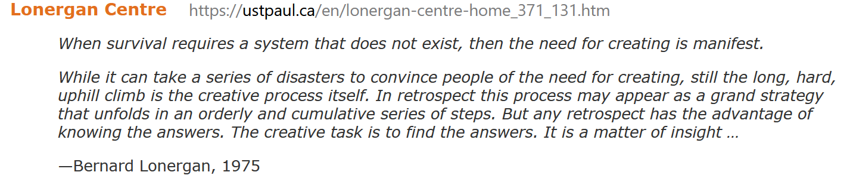
Bernard Lonergan’s Generalized Empirical Method (GEM)
This model is the result of a study that Lonergan did on human understanding. His method clarified the human cognition cycle in great detail. It is a highly iterative process occurring until an action is taken and then the cycle continues. This following is just a skeleton of it:
EXPERIENCE — being attentive
UNDERSTANDING — being intelligent
JUDGMENT — being reasonable
ACTION — being responsible
The ideal is to use this model to architect a future AI system with these highly related and interacting various cognitive capabilities.

Slide 37
Best Moral Practices 1 of 2
In making moral decisions, one must identify the options, reduce risks and uncertainties, and select the best option considering the context and stakeholders based on their own goals and values. Moral decision-making that involves others is much more difficult to achieve and manage because of possible conflicting goals and value systems. One must also deal with moral uncertainties. This process requires consultation, deliberation, and a degree of rationality, rigor, and transparency with all stakeholders. There are well-established ethical guidelines for making ethical decisions in the medical field. We will see this in the next slide.
In addition, there are other ethics framework to be considered, such as justice, rules/laws, care ethics, virtue ethics, environmental ethics, and bioethics, which often look at humans, animals, and ecologies on the receiving end of interactions. There is now a new need to expand the scope of agencies (currently human) to include ICTs and perhaps even include their makers, maintainers, operators, and owners as “remote agents” themselves needing to consider the effect of ICTs on users, citizens, groups and others.

Slide 38
Best Moral Practices 2 of 2
Dr. Marna S. Barrett from the University of Pennsylvania School of Medicine has identified the following ethical principles:
autonomy (the right to non-interference and self-determination),
beneficence (mercy, kindness, and charity to others),
empathy (the ability to experience the experience of others),
fidelity (faithfulness to duties or obligations),
justice (benefits, risks, and costs distributed fairly),
non-maleficence (the requirement to avoid harm or risk of harm), and
universalizability (all moral principles/judgments have universal applicability).
AI systems making decisions should be compliant with these foundational principles. Any AI with hypotheses, goals, and plans that would possibly yield an outcome that would break these principles should not be enacted. Self-testing!

Slide 39
4. Further Analysis (Judging)
Preconditions in Trusting AI Systems
Looking at Other Pieces of the Mind Puzzle
Self-Evaluation & Explanation of Analysis

Slide 40
Preconditions in Trusting AI Systems
The preconditions in trusting AI Systems must include as a minimum, accountability, verifiability, explain-ability, and transparency. Furthermore, there will be high-risk use cases (e.g., high impact, lethal, etc.) where ethical/moral decisions would require humans in the loop . These sorts of considerations should be part of the governance of AI in various jurisdictions.
The idea that there are moral decisions that cannot be attributable to only one actor or decision-maker, be it a human and/or an AI system is troublesome. For example, the idea of Distributed Moral Responsibility (DMR) links humans and/or AI Systems as moral agents in the process of making moral decisions. Floridi wrote in a 2016 article on this subject, “Faultless responsibility: On the nature and allocation of moral responsibility for distributed moral actions.” https://doi.org/10.1098/rsta.2016.0112
Should DMRs and Distributed Moral Actions (DMAs) be permitted? How?TBD

Slide 41
Looking at other Pieces of the Mind Puzzle
Was Descartes wrong when he said, “I think therefore I am”?
Can we build awareness/consciousness (self-testing) into AI systems as an architectural construct? Being aware of our states of mind and our emotions is needed in order for us to understand the world around us, but the role our subconscious minds (model memories) have in our cognitive abilities is unclear. Lonergan states that human emotions are a very important aspect of the cognitive cycle that involves intuition, creativity, and innovation (inferring, predicting, extrapolating).
The mind draws parallels between the micro- and macroscopic levels from atoms to galaxies. The mind often acts as a context-switching machine between what it knows in one domain and its possible applications in another. Learning from one context and applying it or combining it to another is what multidisciplinary teams do well. Can AI patterns in one situation be re-used in another at a meta level? We believe that Lonergan’s insight and methods can give us a path to lead to a useful form of non-deterministic (free will!) machine intelligence/ assistance.

Slide 42
Self-Evaluation & Explanation of Analysis
This presentation aims to highlight the importance of ethical judgment questions about AI and our relationship to it and make a thesis statement while being logical, clear, authentic, and encompassing all of what it means to be human with the right emotions, respect, empathy, and responsibility to others as per Lonergan’s teachings.
Surprisingly, the analysis is leading to the emergence of a bottom-up way for getting to artificial morality. In previous views, we thought morality could be fully captured and rendered into an AI system (e.g., an expert system) from the top looking at general moral rules, acknowledging that some top principles would be needed. In discovering Lonergan’s views and methods, however, we are seeing the adaptability of it to real-life problems and moral questions that are constantly evolving. Lonergan is grounded in applied ethics to resolve real issues of the day. The idea is that artificial morality using synthetic emissions and Lonergan’s cognitive method could be used in real-time to the real world ethically. TBD…

Slide 43
5. Conclusions & Recommendations for Future Work (Acting) 1 of 7
Considering that Dr. Hagendorff has done an extensive review in his report “The Ethics of AI Ethics” by tabulating AI principles from all around the world, from academics, institutions, and various governments, he has discovered that there are many ethical gaps that need to be addressed.
Efforts must be made at the international level regarding the governance of AI, if we are to trust AI systems “leaking” into our lives for good. International agreements are needed on AI development and use, as we now live in a post-Westphalian world. The infosphere knows of no geopolitical boundaries, but affects the sovereignty of every nation. AI is becoming a strategic ally that we must learn to depend on and trust.
AI systems will be key to achieving information superiority for our freedom, peace, prosperity, and security.

Slide 44
5. Conclusions & Recommendations for Future Work (Acting) 2 of 7
ICTs powered with AI technology are becoming ubiquitous, as we live in a cyber-culture where our world is being digitalized into a neo-dualism with the physical world. As a result, the public and private spheres are collapsing, leaving individuals open to the immoral use of AI systems.
Given that we are now in the middle of the fourth industrial revolution where enhanced cognitive power is required to augment production, it is understood that there will be more pressure to develop more AI capabilities to meet the demands of a growing population living in an interconnected digital world.
Given that AI systems are affecting every aspect of our lives, we have a duty to ensure they are doing good for humanity (i.e. AI4SG).
Given that our living environment is going beyond human cognition, we will become more and more dependent on AI Systems.

Slide 45
5. Conclusions & Recommendations for Future Work (Acting) 3 of 7
These AI systems will make decisions affecting human lives so we must, as a minimum, make these systems accountable, verifiable, transparent, and explainable. We should trust artificially intelligent systems to make moral decisions, if we can test and validate that they are indeed accountable, verifiable, transparent, and explainable to society and its citizens.
With evolving ICTs (e.g. 5G, IoT, etc.), we are now enabling further distribution of responsibilities, moral agencies, and decision-making. We will need to allow morally correct AI systems to participate and contribute positively to this new social and technological distributed cyber environment. Based on the above statements, it is safe to say that AI systems are here to stay. We definitively must learn to live with them.
In addition, it is inevitable that AI systems will have to make decisions that will require capabilities to make moral choices and proposals. Therefore, we will have to trust AI systems to make decisions to a certain level, but there will have to be guidelines, standards, policies, and even laws to frame the use and development of AI. The requirement for the development of “artificial morality” could lead to the safe use of AI with moral agency.

Slide 46
5. Conclusions & Recommendations for Future Work (Acting) 4 of 7
We could see AI systems having moral agency as a necessary capability of modern life. Using Lonergan as a cognitive framework to discover moral knowledge, it is possible to conceive that AI systems could be built to emulate Lonergan’s Generalized Empirical Method (GEM). The “self” as moral agent could use a set of best moral practices to self-test itself on the various options making predictions for the “good” and consequences as outcomes before making a proposal, making a moral decision, or taking an ethical action in the end.
Using teleology as a philosophy for making moral decisions in AI systems is what is recommended for now. As R.M. Hare states that this philosophy is good as a comparative way of looking at possible outcomes, as opposed to the more complex deontological manner. Given that AI systems are models that are developed using optimization algorithms, it is a good natural initial fit with this teleological means of assessing moral decisions.
In addition, there is a real-time imperative for using teleology to make good AI moral decisions in autonomous systems, where the outcomes must be highly probable.

Slide 47
5. Conclusions & Recommendations for Future Work (Acting) 5 of 7
We should agree that doing “the good” should be good enough for AI systems in real-time. In other cases (e.g. policy making, legal advice, bioethics, etc.), however, there may be a need to develop AI systems that would take a higher deontological moral view, going from the science of ends (teleological) to the science of causes (deontological).
In addition, as Lonergan indicates, part of the cognitive cycle requires feelings and emotions to help evaluate the “intention of values” of the various possible goods. Emotions and their recall are useful and perhaps necessary for moral discernment and judgment. We have seen that AI systems could use synthetic emotion models to include emotional aspects in the evaluation of values of good.
Lastly, Lonergan’s insights with emotion and our awareness of them can lead to intuition and innovation during analysis. It is conceivable that AI systems could use synthetic emotional models to lead to other concepts and make a connection to a related, but different idea or option to consider, based on the relation between learned “emotions” and moral decisions.

Slide 48
5. Conclusions & Recommendations for Future Work (Acting) 6 of 7
From a theoretical point of view, according to Floridi, information is knowledge and if new moral knowledge can be discovered by humans, there is no reason to believe that machines could not derive new moral knowledge from information as well. Logically, the better we make AI systems by verifying and validating their moral capabilities, the more trust we will be able to give them. The trust level must be weighted with the potential for errors and the consequences.
It is for us humans to determine proactively who, what, and why should AI4SG be. In fact, AI4SG could consider AI systems as indispensable social partners that we can no longer live without. Furthermore, we believe that AI systems could develop new deeper moral understandings that they could share with us. The time to teach AI how to make moral decisions is now, as it is spreading in existing and new ICTs like wild fire. Because there are AI systems designed with bad intentions, there will be a need to design AI superheroes (i,e., AI on AI).
Ultimately, the AI moral imperative is to teach AI how to make moral decisions before AI reaches the point of no return by having superintelligence without moral capabilities built-in. If we have providence, perhaps superintelligence will solve our moral concerns on its own.

Slide 49
5. Conclusions & Recommendations for Future Work (Acting) 7 of 7
Lastly, we should trust artificially intelligent systems to make moral decisions, if we can build and design them with features that are fully accountable, verifiable, transparent, and explainable to society and its citizens.
Then, like any humans, we can grow our trust in these evolving AI systems, to adequate levels, and go from there in our collaboration with them over time.

Slide 50
Works Cited from the original paper 1 of 4
Adler, Felix. "The Problem of Teleology." International Journal of Ethics 14.3 (1904): 265-280. Document. <https://www.jstor.org/stable/2375917?seq=1#metadata_info_tab_contents>.
Allen, Colin, Wendell Wallach and Iva Smit. "Artificial Morality: Top-down, Bottom-up, and Hybrid Approaches." Ethics and Information Technology 7.3 (2005): 149-155. Document. <https://www.aaai.org/Papers/Symposia/Fall/2005/FS-05-06/FS05-06-015.pdf>.
Awad, Edmond, et al. "The Moral Machine experiment." Nature 563 (2018): 59-64. Document. <https://www.nature.com/articles/s41586-018-0637-6>.
Boddington, P. Towards a Code of Ethics for Artificial Intelligence (Artificial Intelligence: Foundations, Theory, and Algorithms). Cham: Springer, 2017. Print.
Bostrom, Nick. Superintelligence: paths, dangers, strategies. Oxford University Press, 2014. Print.
Bourke, V. J. "Proceedings of the American Catholic Philosophical Association, Volume XLVIII: Thomas and Bonaventure: a Septicentenary Commemoration." Aquinas and Recent Theories of Right. 1974. 187-197. Print.
Broekens, Joost. Modeling the Experience of Emotions. n.d. Document. 2 August 2019. <https://arxiv.org/ftp/arxiv/papers/0903/0903.0735.pdf>.
Byrne, Patrick H. The Ethics of Discernment: Longergan's Foundation of Ethics. University of Toronto Press, 2016. Print.
Coggins, Richard. "Westphalian state system." 2019. Oxford Reference. Document. <https://www.oxfordreference.com/view/10.1093/oi/authority.20110803121924198>.
Collins English Dictionary – Complete and Unabridged. "Infosphere." 20 November 2019. The Free Dictionary. Document. <https://www.thefreedictionary.com/infosphere>.

Slide 51
Works Cited from the original paper 2 of 4
Daly, Angela, et al. Artificial Intelligence Governance and Ethics: Global Perspectives. 28 June 2019. Document. <https://arxiv.org/abs/1907.03848>.
Dunne, Tad. "Bernard Lonergan." n.d. Internet Encyclopedia of Philosophy. Document. <https://www.iep.utm.edu/lonergan/>.
Fieser, James. "Ethics." n.d. Internet Encyclopedia of Philosophy. Document. <https://www.iep.utm.edu/ethics/>.
Floridi, Luciano. "Ethics in the Age of Information." 2016. Oxford Internet Institute. Oxford University. Youtube video. <https://www.youtube.com/watch?v=lLH70qkROWQ>.
—. "Faultless responsibility: on the nature and allocation of moral responsibility for distributed moral actions." Philosophical Transactions A 15 August 2016. Document. <https://royalsocietypublishing.org/doi/pdf/10.1098/rsta.2016.0112 >.
—. "Hyperhistory and the Philosophy of Information Policies." Philosophy & Technology (2012): 129-131. vol 25 no 2.
—. The Philosophy of Information. Oxford: Oxford University Press, 2011. Print.
Foroughi, Hamid, Yiannis Gabriel and Marianne Fotaki. "Leadership in a post-truth era: A new narrative disorder?" Leadership 15.2 (2019): 135-151. Document. <https://journals.sagepub.com/doi/10.1177/1742715019835369>.
Government of Canada. "Directive on Automated Decision-Making." 5 February 2019. Government of Canada. Document. <https://www.tbs-sct.gc.ca/pol/doc-eng.aspx?id=32592>.
—. "Responsible use of artificial intelligence (AI)." n.d. The Government of Canada. <https://www.canada.ca/en/government/system/digital-government/modern-emerging-technologies/responsible-use-ai.html>.
Hagendorff, Thilo. The Ethics of AI Ethics: An Evaluation of Guidelines. 2019. Document. <https://arxiv.org/ftp/arxiv/papers/1903/1903.03425.pdf>.

Slide 52
Works Cited from the original paper 3 of 4
Harris, Sam. The Moral Landscape: How Science Can Determine Human Values. 1st edition. Free Press, 2010. Print.
Jonas, Hans. "Technology and Responsibility: Reflections on the New Tasks of Ethics." Social Research (1973): 31-54. Document. <http://www.jstor.org/stable/40970125>.
—. The Imperative of Responsibility: in Search of an Ethics for the Technological Age. University of Chicago Press, 1984. Print.
Lonergan, Bernard J. F. Insight: a Study of Human Understanding. Philosophical Library, 1958.
Martin, Inés San. "Pope warns of ‘new barbarism’ in age of artificial intelligence." Crux 28 September 2019. Document. <https://cruxnow.com/vatican/2019/09/pope-warns-of-new-barbarism-in-age-of-artificial-intelligence/>.
Merriam Webster. "Machine learning (noun)." n.d. Dictionary by Merriam Webster. Document. <https://www.merriam-webster.com/dictionary/machine%20learning>.
Merriam-Webster. "Agency (noun)." n.d. Document. <https://www.merriam-webster.com/dictionary/agency>.
—. "Artificial intelligence (noun)." n.d. Dictionary by Merriam-Webster. Document. <https://www.merriam-webster.com/dictionary/artificial%20intelligence>.
—. "Decision (noun)." n.d. Dictionary by Merriam-Webster. Document. <https://www.merriam-webster.com/dictionary/decision>.
—. "Ethic (noun)." Dictionary by Merriam-Webster (n.d.). Document. <https://www.merriam-webster.com/dictionary/ethics>.
—. "Free will (noun)." n.d. Dictionary by Merriam-Webster. Document. <https://www.merriam-webster.com/dictionary/freewill>.
—. "Nondeterministic (noun)." n.d. Dictionary by Merriam-Webster. Document. <https://www.merriam-webster.com/dictionary/nondeterministic>.

Slide 53
Works Cited from the original paper 4 of 4
"Transcendence (noun)." n.d. Dictionary by Merriam-Webster. Document. <https://www.merriam-webster.com/dictionary/transcendence>.
—. "Transcendent (adjective)." n.d. Dictionary by Merriam-Webster. Document. <https://www.merriam-webster.com/dictionary/transcendent>.
—. "Trust (noun)." n.d. Dictionary by Merriam-Webster. Document.
Parvin, Phil. "Democracy Without Participation: A New Politics for a Disengaged Era." Res Publica 24.1 (2018): 31-52. Document. <https://link.springer.com/article/10.1007/s11158-017-9382-1>.
Qualman, Darrin. "Unimaginable output: Global production of transistors." 4 April 2017. Darrin Qualman: Author, civilizational critic, long-term thinker, researcher, speaker. Document. <https://www.darrinqualman.com/global-production-transistors/>.
quotetab.com. Hans Jonas Quotations - Affect Quotes. 2019. Document. 4th December 2019.< https://www.quotetab.com/quotes/by-hans-jonas#3jC3qF79ocYOkdYl.97>
Rose-Wiles, Marian Glenn and Doreen Stiskal. "Enhancing Information Literacy Using Bernard Lonergan's Generalized Empirical Method: A Three-Year Case Study in a First Year Biology Course." The Journal of Academic Librarianship 43.6 (2017): 495-508. Document.
Spîrchez, Georgeta-Bianca. The Relation Between Ethics And Law. Bucharest, 2016. Document. <http://oaji.net/articles/2016/2064-1480331083.pdf>.
The Merriam-Webster Dictionary of English Usage. 1989.
University of Oxford. "Professor Luciano Floridi." 2016. Oxford Internet Institute. Document. <https://www.oii.ox.ac.uk/people/luciano-floridi>.
Winston, Morton E. and Ralph D. Edelbach. Society, Ethics and Technology. Boston: Wadsworth, Cengage, 2014. Print.

Slide 54
Questions – comments – views – suggestions

Slide 55
Extra Slides start here

Slide 56

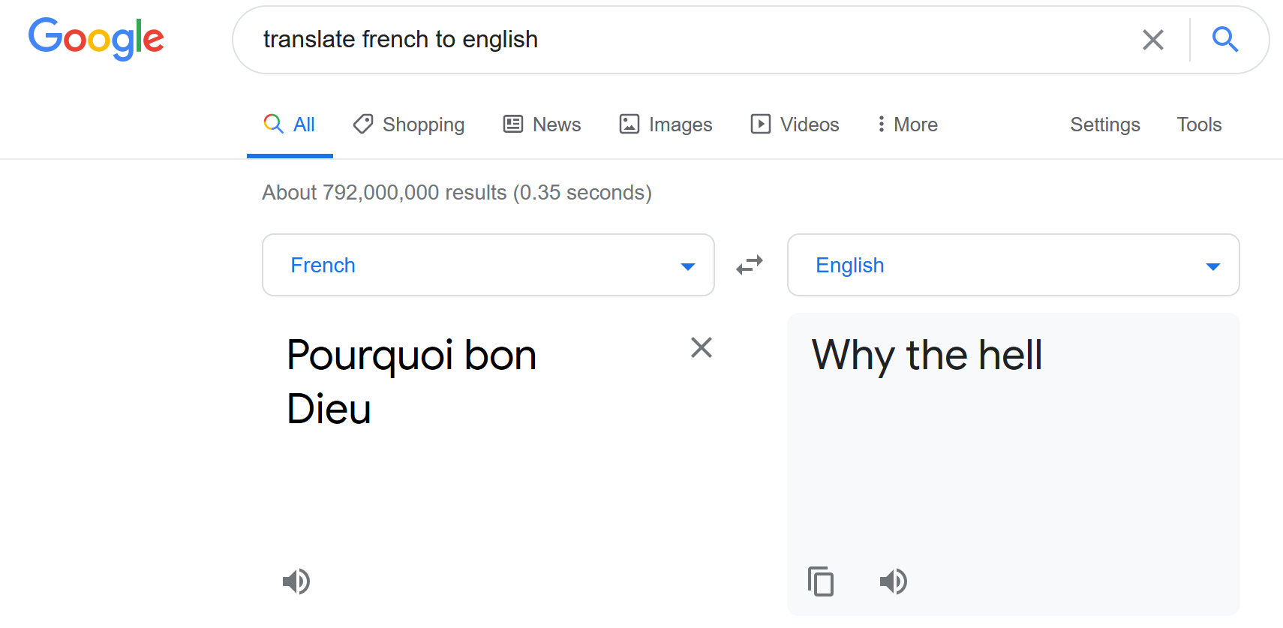
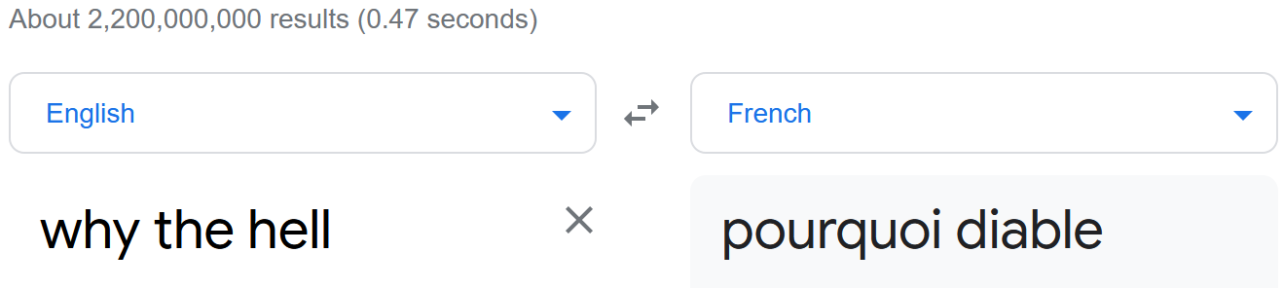
Google AI translate is not consistant
Gilles Dreu "Pourquoi bon Dieu" why the hell
https://www.youtube.com/watch?v=w2b1ttTCuAQ&list=RDpo9YEH9FSTk&index=6 a 3.22 mins experience
This difference makes a meaningful change to the real meaning/tone of this song by Gilles Dreu.
What else is Google changing? Who monitors, validates and/or controls Google Translate and other AIs?

Slide 57
Original French Text
AI Google Translated Text
1. Why the hell
2. Why did you go to so much trouble to do all of this?
3. Why the hell
4. Do you make the dogs fight against the cats?
5. Why the hell
6. That spider that my foot is going to crush?
7. Why the hell
8. That gazelle that the lion will devour?
9. And all these people so different
10. Some black skinned others white
11. Who do not understand each other
12. And who don't love each other
13. One small, the other large
14. The good guys the bad guys
15. Explain to me this problem if you want that
16. I love you, you want me to love you
17. Why the hell
18. Did you go to so much trouble to do all of this?
19. Why the hell?
20. You must have your reasons but tell me!
21. Why the hell?
22. I was nevertheless very quiet in nothingness
23. Why the hell
24. Am I just a little dwarf, you a giant?
25. Paradise is very pretty
26. But I never win the lottery
27. And this time I'm losing
28. I'm good for hell
29. I didn't want a ticket
30. It was you who forced me
31. Explain this problem to me
32. If you want me to love you
33. You want me to love you
34. Why the hell
35. Did you go to so much trouble to do all of this?
36. Why the hell
37. Did you go to so much trouble just for me?
38. Why the hell?
39. Why the hell?
40. Why the hell?
1. Pourquoi Bon Dieu
2. Pourquoi t'es-tu donné tant de mal pour faire tout ça ?
3. Pourquoi Bon Dieu
4. Fais-tu se battre les chiens contre les chats ?
5. Pourquoi Bon Dieu
6. Cette araignée que mon pied va écraser ?
7. Pourquoi Bon Dieu
8. Cette gazelle que le lion va dévorer ?
9. Et tous ces gens si différents
10. Les uns à la peau noire les autres blancs
11. Qui ne se comprennent pas
12. Et qui ne s'aiment pas
13. Les uns petits les autres grands
14. Les gentils les méchants
15. Explique-moi ce problème si tu veux que
16. Moi je t'aime, tu veux que je t'aime
17. Pourquoi Bon Dieu
18. T'es-tu donné tant de mal pour faire tout ça ?
19. Pourquoi Bon Dieu ?
20. Tu dois avoir tes raisons mais dis-les moi !
21. Pourquoi Bon Dieu ?
22. J'étais pourtant bien tranquille dans le néant
23. Pourquoi Bon Dieu
24. Ne suis-je qu'un petit nain toi un géant ?
25. Le Paradis c'est bien joli
26. Mais je ne gagne jamais à la loterie
27. Et cette fois-ci je perds
28. Je suis bon pour l'enfer
29. Je ne voulais pas de billet
30. C'est toi qui m'a forcé
31. Explique-moi ce problème
32. Si tu veux que moi je t'aime
33. Tu veux que je t'aime
34. Pourquoi Bon Dieu
35. T'es-tu donné tant de mal pour faire tout ça ?
36. Pourquoi Bon Dieu
37. T'es-tu donné tant de mal rien que pour moi ?
38. Pourquoi Bon Dieu ?
39. Pourquoi Bon Dieu ?
40. Pourquoi Bon Dieu ?
13/40
32.5%

