Slide 1
Notes for an FSN Zoom Session 29.01.21
To accompany Moderator’s Notes for next zoom session:
29 January, 2021:
Whither the post-election USA - scenarios to 2031/Guy Stanley

Slide 2
Conclusion: Four Strategic Policy Moves to preserve/delay loss of hegemon status​
Game-changing tech revolution - possibly on the horizon;
Intensify Cold War Rhetoric and decouple China from its trade with US Allies, such that the US then occupies those spaces;
Work with China on dual roles as coordinator of multilateral solutions to global problems of climate change, the anthropocene, poverty, human settlement etc.;
Force China to make a significant mistake - such as the wrong-headed military involvements that wasted US resources since 9-11-2001 (Also a source of “wildcards”)!

Slide 3
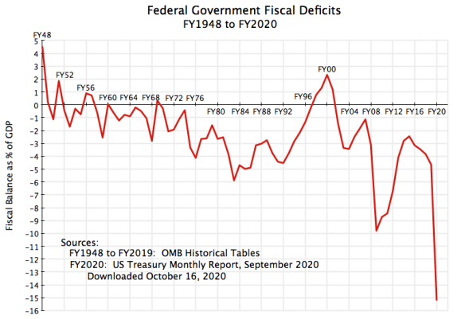

Slide 4
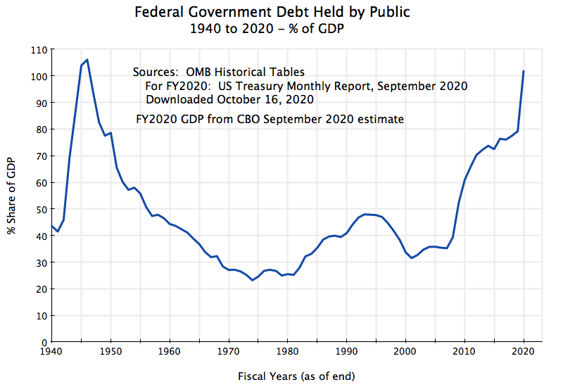

Slide 5
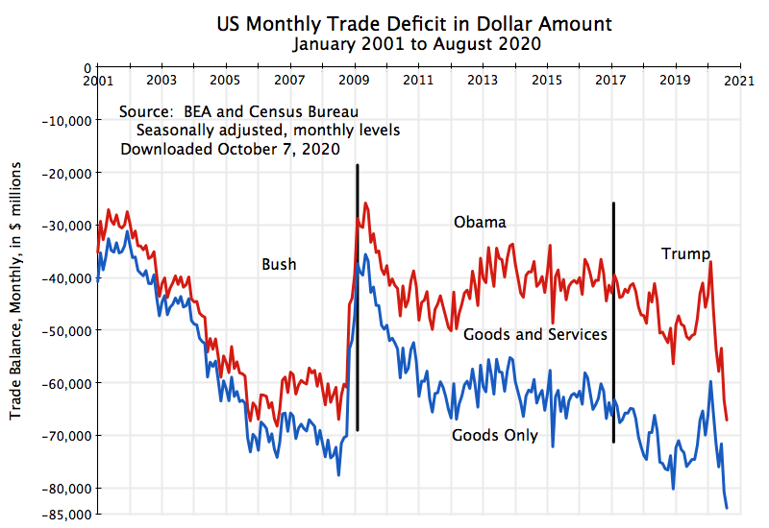

Slide 6
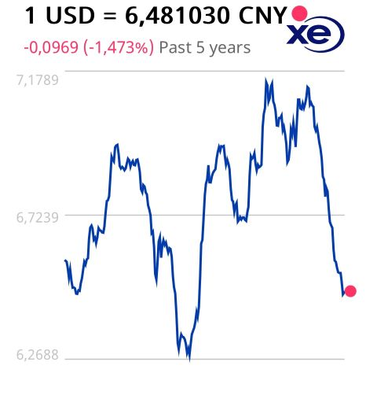
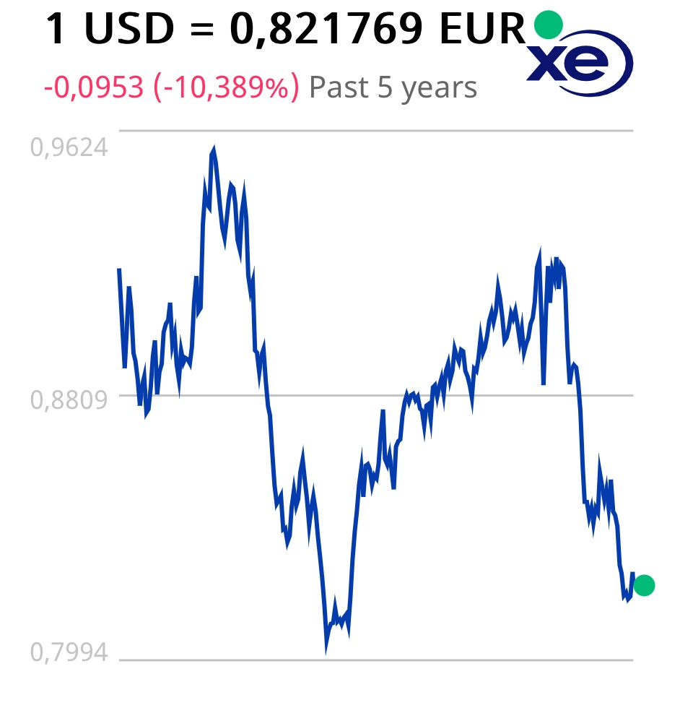
5 year exchange rate trends
Harbingers: 2015 – Rmb gains SDR status, 10.92%, n.3 after US, Euro
2018 March – first petro futures contract, breaking $ monopoly

Slide 7
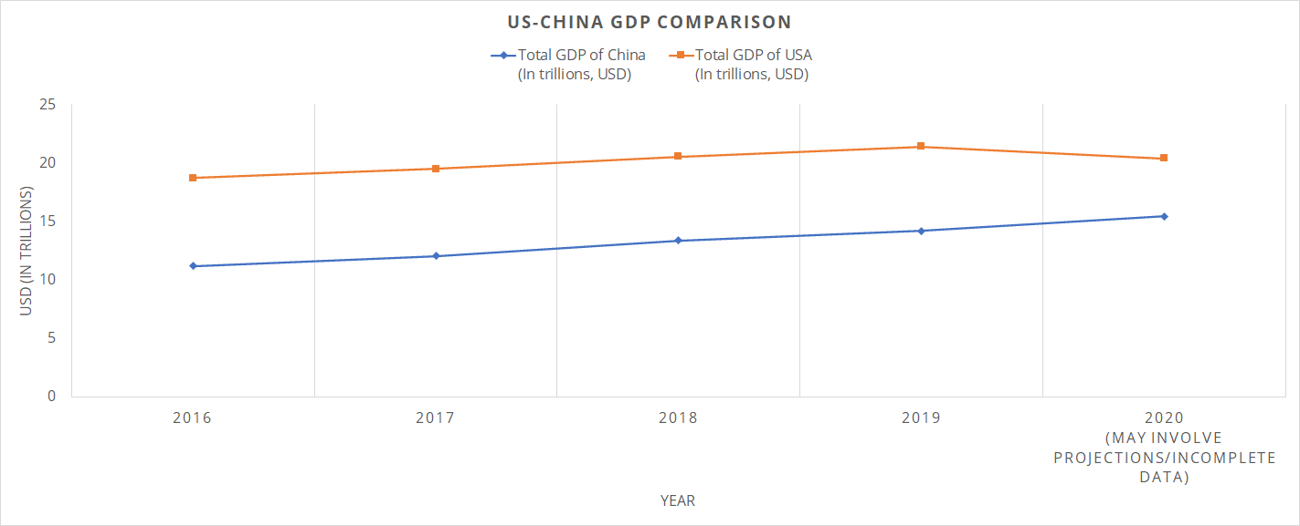
US-China GDPCompared

Slide 8
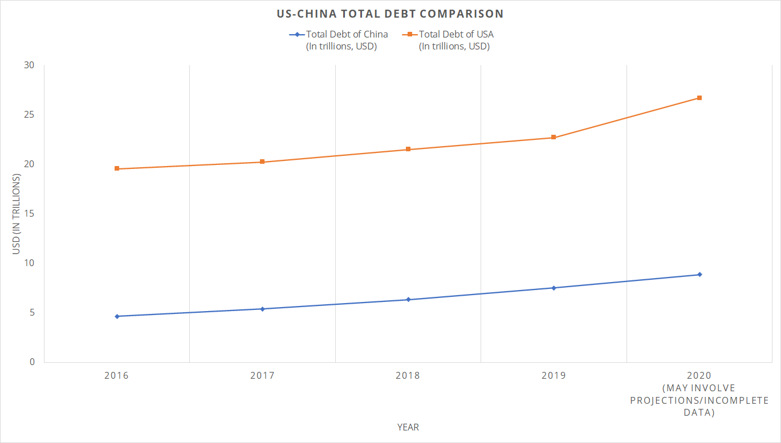
US-China Debt Compared

Slide 9
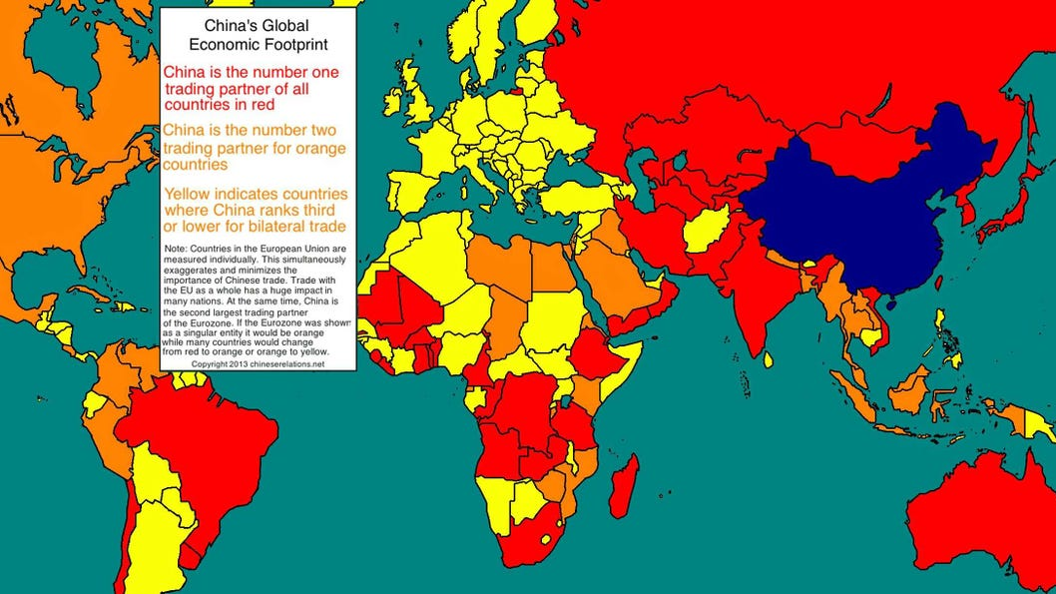
China's Global Economic Footprint

Slide 10
The United States has free trade agreements in force with 20 countries. These are:
Australia
Bahrain
Canada
Chile
Colombia
Costa Rica
Dominican Republic
El Salvador
Guatemala
Honduras
Israel
Jordan
Korea
Mexico
Morocco
Nicaragua
Oman
Panama
Peru
Singapore
USMCA

Slide 11
China's Free Trade Agreements
Regional Comprehensive Economic Partnership (RCEP)
China-Cambodia FTA
China-Mauritius FTA
China-Maldives FTA
China-Georgia FTA
China-Australia FTA
China-Korea FTA
China-Switzerland FTA
China-Iceland FTA
China-Costa Rica FTA
China-Peru FTA
China-Singapore FTA
China-New Zealand FTA
China-Chile FTA
China-Pakistan FTA
China-ASEAN FTA
Mainland and Hong Kong Closer Economic and Partnership Arrangement
Mainland and Macao Closer Economic and Partnership Arrangement
China-ASEAN FTA Upgrade
China-Chile FTA Upgrade
China-Singapore FTA Upgrade
China-Pakistan FTA second phase

Slide 12
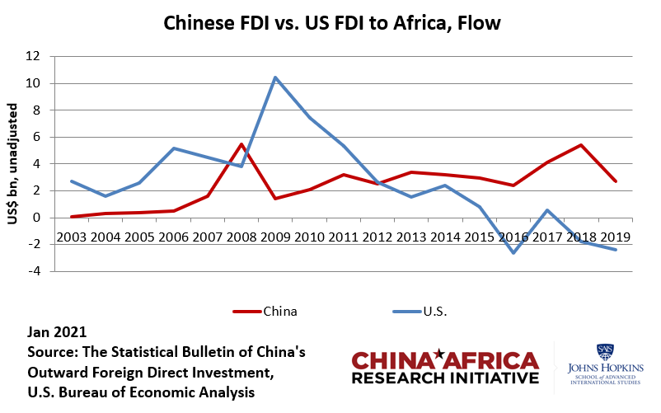
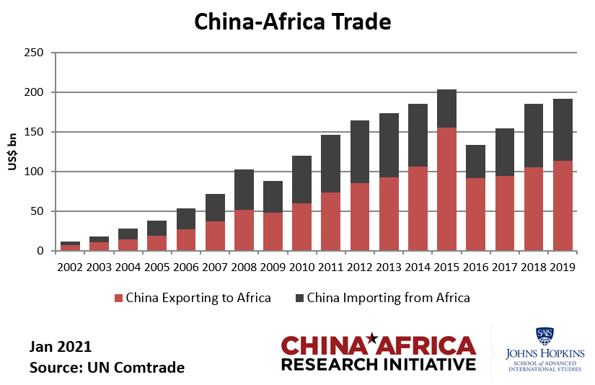
China – US Africa FDI & Trade

Slide 13
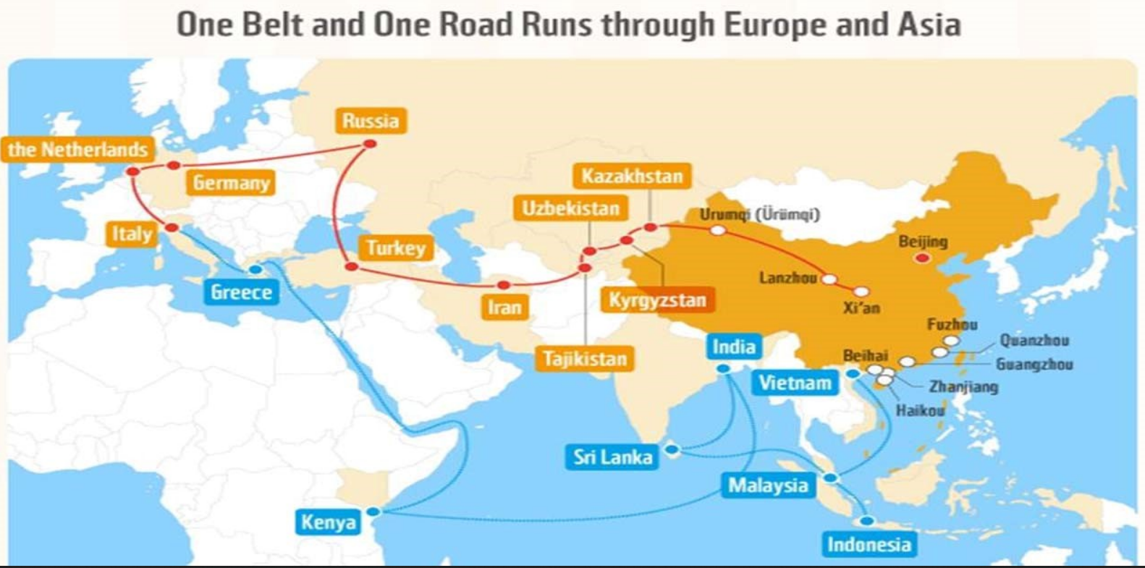

Slide 14
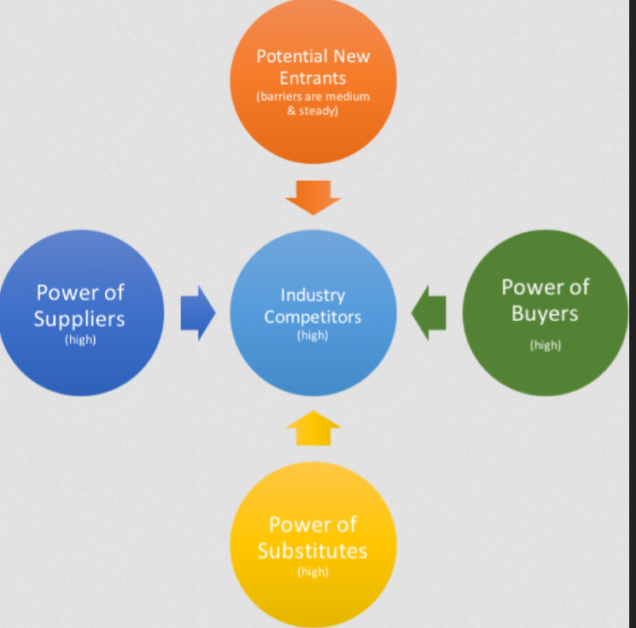
Porter's 5-factor competition model

Slide 15
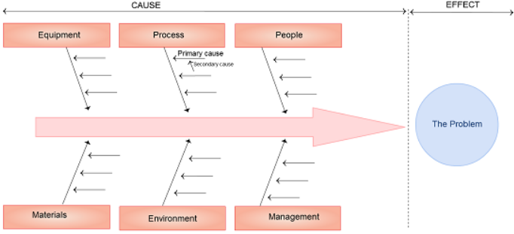
Asian Model – Underlining some differences

Slide 16
Conclusion: Four Strategic Policy Moves to preserve/delay loss of hegemon status​
Game-changing tech revolution - possibly on the horizon;
Intensify Cold War Rhetoric and decouple China from its trade with US Allies, such that the US then occupies those spaces;
Work with China on dual roles as coordinator of multilateral solutions to global problems of climate change, the anthropocene, poverty, human settlement etc.;
Force China to make a significant mistake - such as the wrong-headed military involvements that wasted US resources since 9-11-2001 (Also a source of “wildcards”)!

