Slide 1
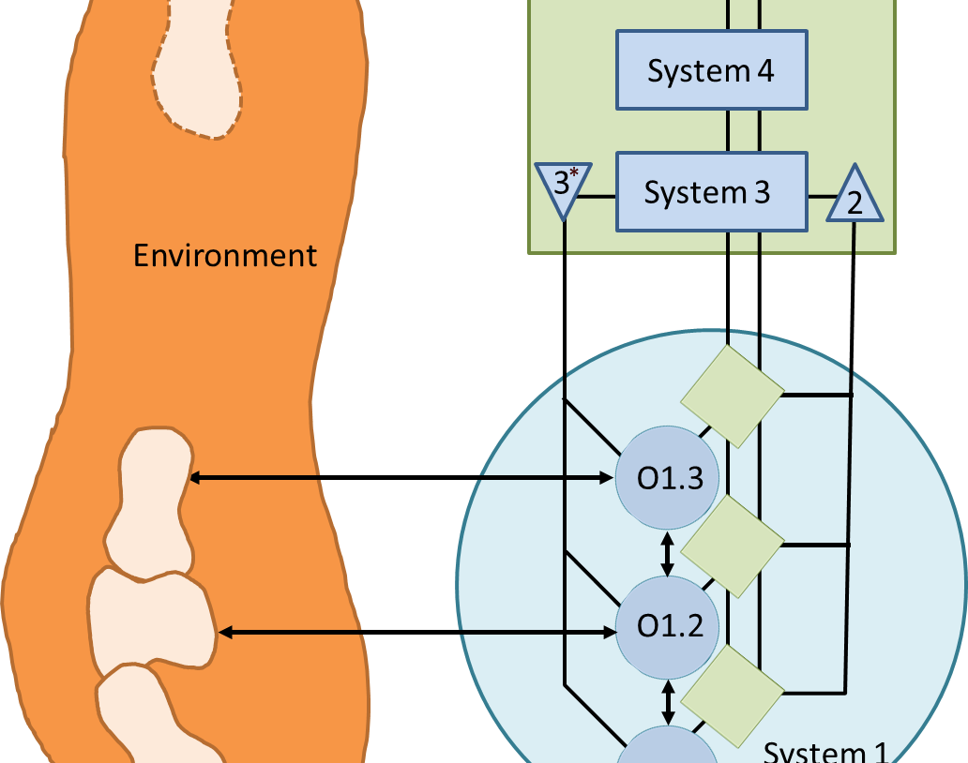
Viable System Model
A better way to build organizations?

Slide 2
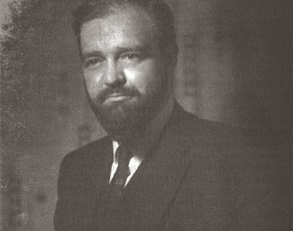
Viable System Model
Stafford Beer sought laws of organization. From this search he built the Viable System Model.

Slide 3
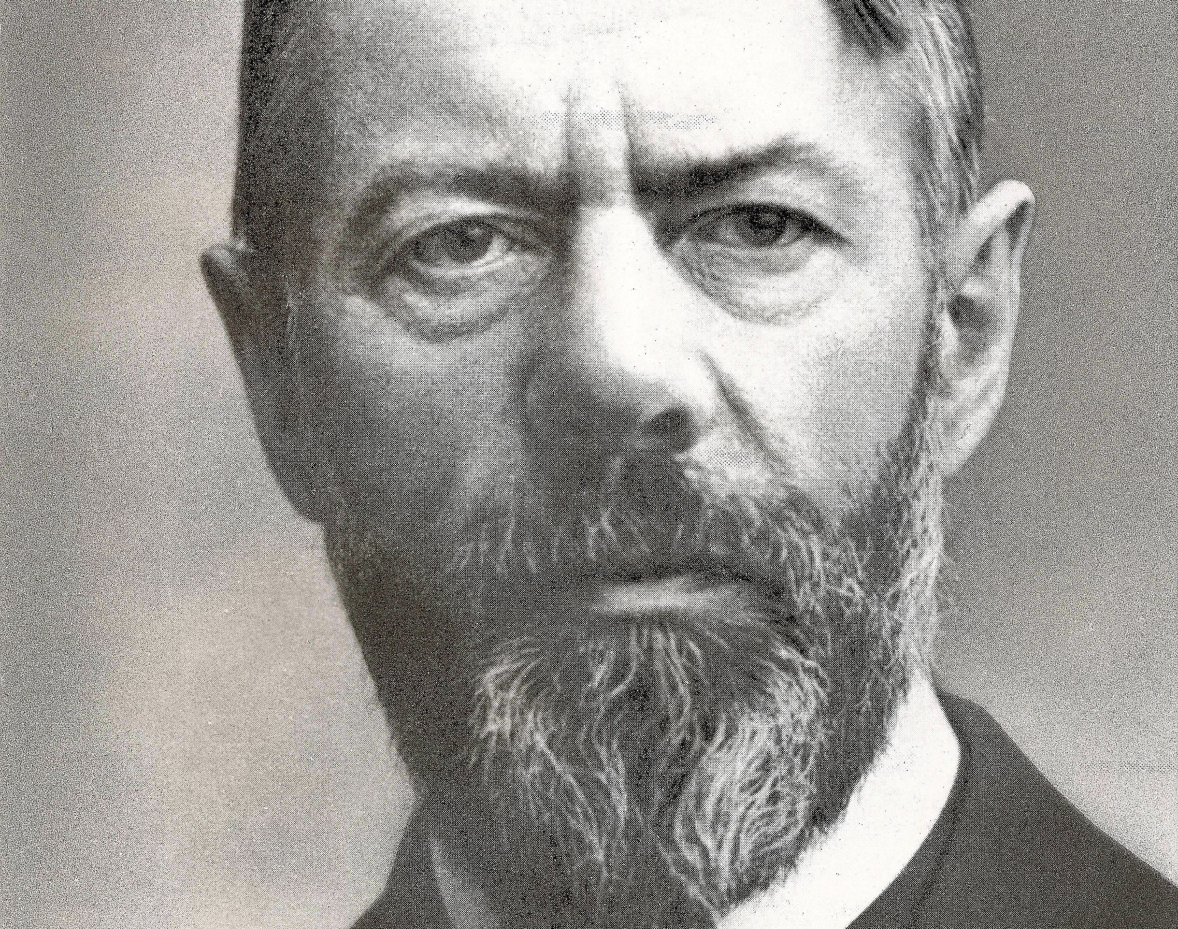
Bureaucracy
Max Weber, German sociologist, thought bureaucracy most efficient, best system for human labour.

Slide 4
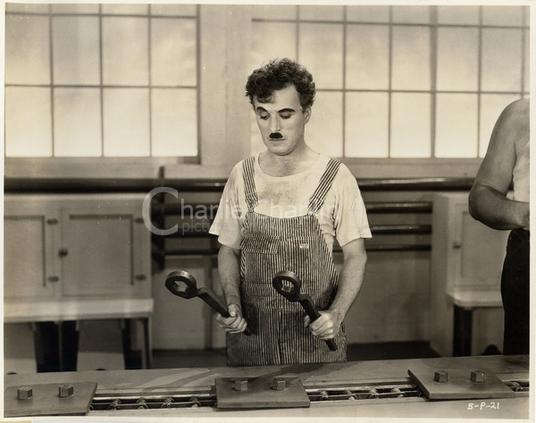
Bureaucracy becomes black.
Most here have worked for large bureaucracies. Many now think of
Inefficiency
absurdity
wastefulness
ineffectiveness
inflexibility

Slide 5
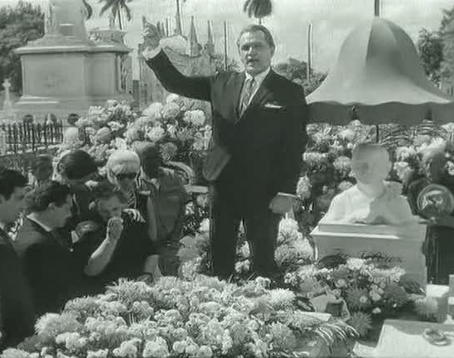
Death of a bureaucrat
Absurdity of bureaucracy
1966 Cuban film
Dead man can’t be buried unless he signs a note to permit it.

Slide 6
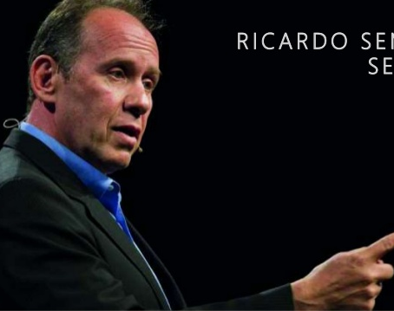
Information organization
Resilience
Communications
Speed
Adaptability

Slide 7
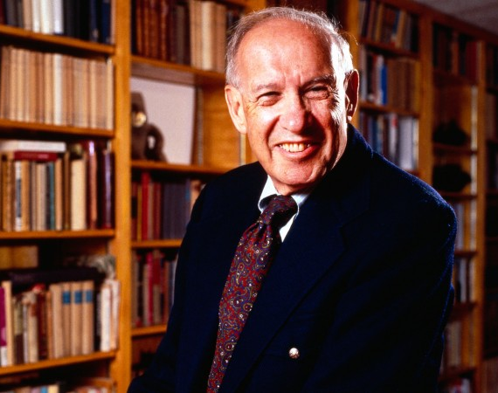
Peter Drucker
Old organizations based upon energy flows. New organizations based upon information flows.

Slide 8
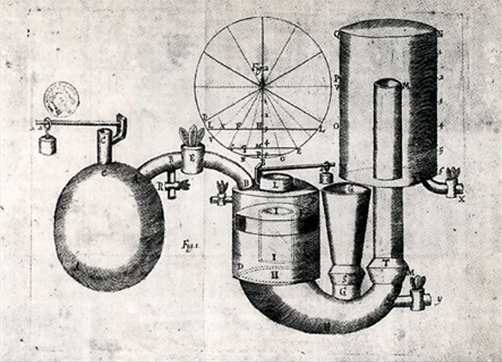
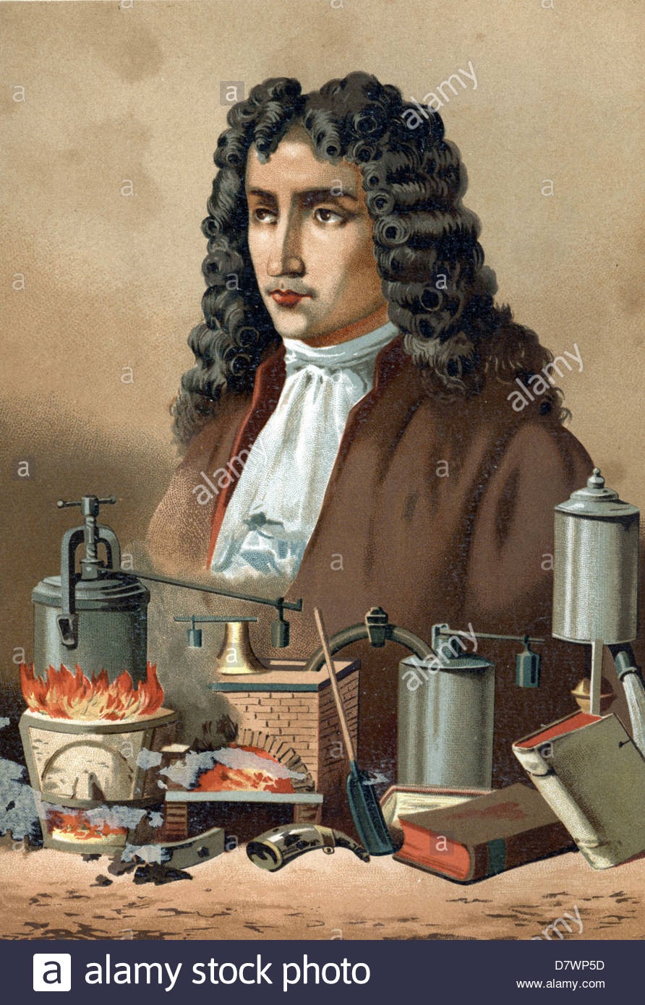
Denis Papin Steam engine 1680
Bureacratic model started with steam engine.

Slide 9
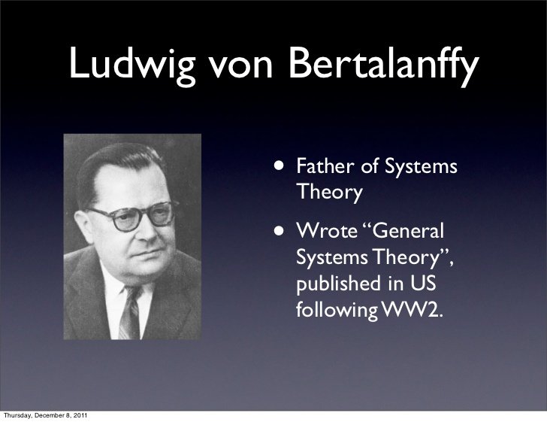
Von Bertallanfy Systems
Then came a new paradigm: information, based upon biological models. Ludwig von Bertalanffy studied this.

Slide 10
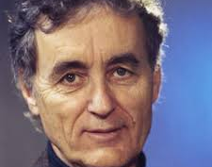
Frijtoff Capra
“All living systems are networks”

Slide 11
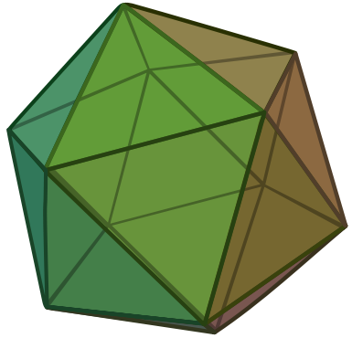
Buckminster Fuller
All Systems are polyhedra, said Buckminster Fuller..
That means, rather than a 2 dimensional organization chart, we have a 3 dimensional one.

Slide 12

Alfred North Whitehead
In Science and the Modern World (1925), Whitehead stated that a new paradigm for seeing nature is coming to the fore: the organic view. Here every piece of a system is a replica of the whole.

Slide 13
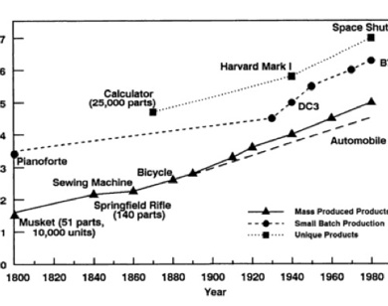
Why bureaucracy fails
Complexity:
Two sources:
Environment (technological)
Inside (complexity to deal with environment)

Slide 14
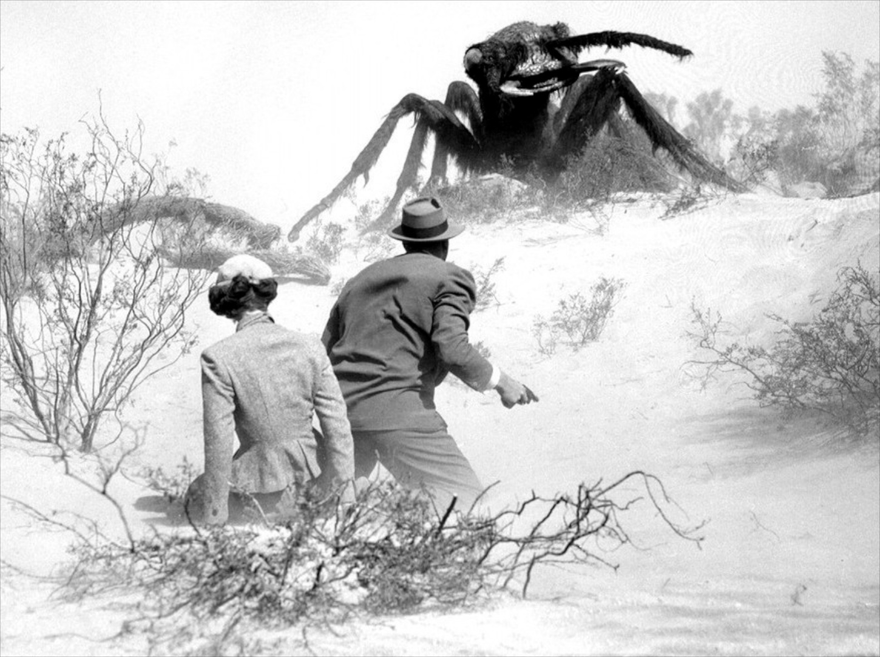
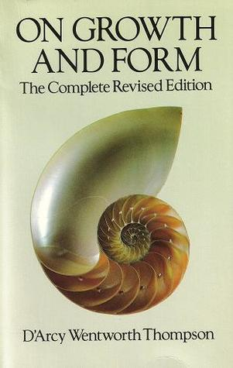
Why bureaucracy fails
D’Arcy Thompson, On Growth and Form
Problem of the giant ants.

Slide 15
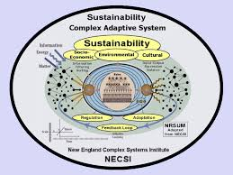
Other drawback of bureaucracy
To solve wicked problems, we need complex adaptive system

Slide 16
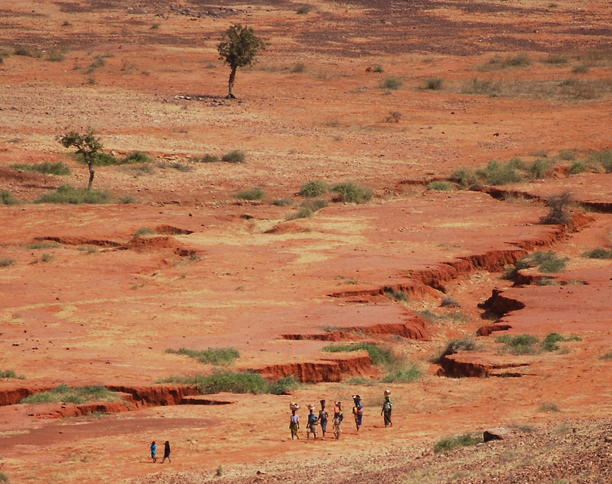
Wicked Problems
Pollution
Food production
Potable water
Desertification
Global Warming
Drug crime
Terrorism
Cyberwarfare

Slide 17
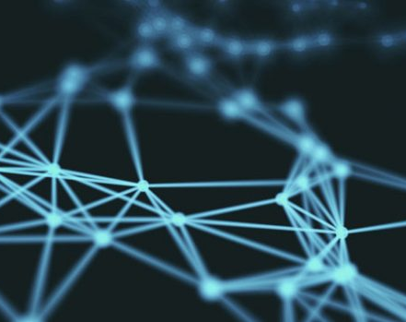
Info versus energy based organization
Energy based organization: top-down, command and control
Info based organization: network, local autonomy

Slide 18
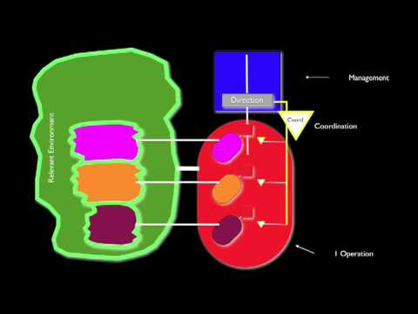
The Viable System Model as Solution
Beer designed an organization that would adapt and survive its environment. (cf. structural coupling – Maturana Varela).
Sought universal laws.

Slide 19
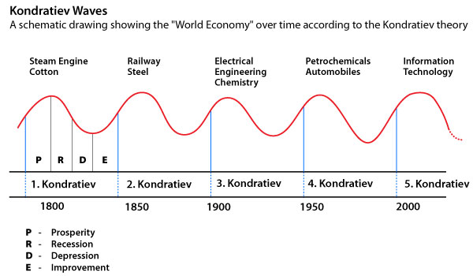
Complexity environment cycles
What has made the environment vastly more complex than in Weber’s time is this: Kondratieff Cycles of 50 years.

Slide 20
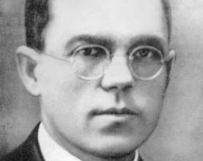
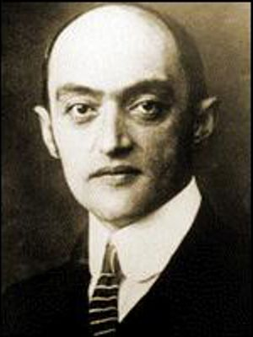
Nikolai Kondratieff Joseph Schumpeter
Kondratieff discovered 50 year (long-term) economic boom and bust cycles.
Schumpeter: new technologies stimulated recovery.

Slide 21
Technology and Complexity
New technologies, new complexity:
Moving parts:
Steam locomotive: c. 3,000
Car: c. 10,000
Computer: Intel Chip: 100,000,000 transistors
Biotech: gene: 3.2 billion bases of DNA in human genome.
.

Slide 22
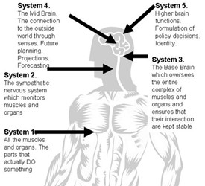
Beer’s Solution
Viable System Model: what makes an organism or organization survive?
Beer studies most complex information processing: human nervous system.

Slide 23
Nervous System – Viable System Model
Nervous System | Viable System Model
1. Kinesthetic- Proprioceptive | 1. Operations
2. Limbic System | 2. Coordination
3. Medulla | 3. Audit, Control, Resource Bargain
4. Diencephelon | 4. Future: connects control with policy
5. Neo-Cortex | 5. Policy

Slide 24
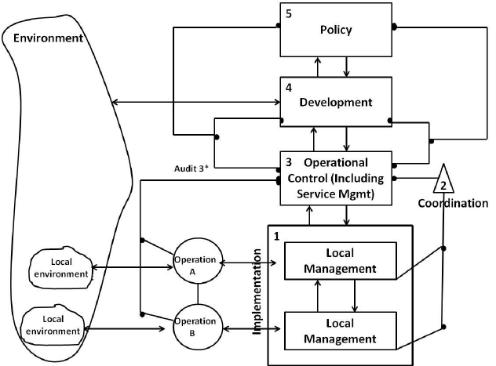
Basic Unit
In a basic unit, the VSM has these five functions. The basic unit nests in higher units with the same five functions.

Slide 25
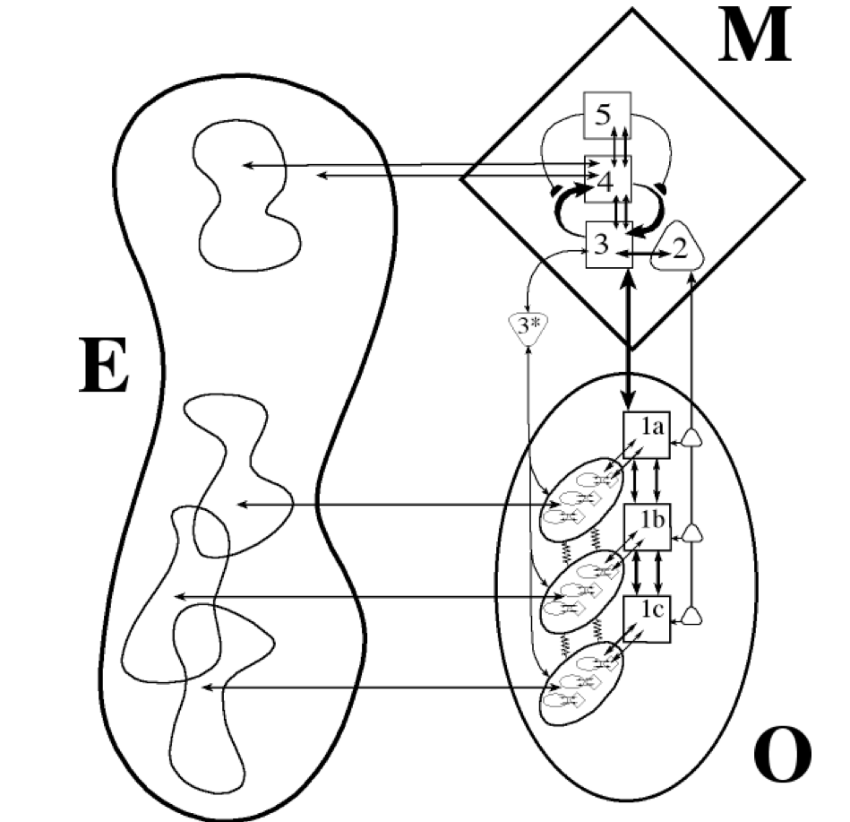
Concatenation (Fractal Russian dolls)
Viable Systems are like Russian dolls, or fractals. They contain like viable systems, which, in turn, contain like viable systems.

Slide 26
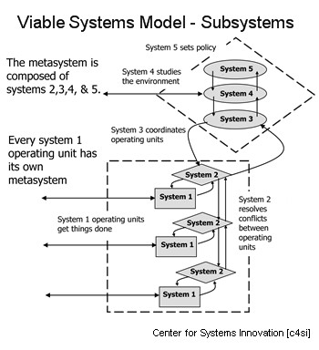
Bureaucracy:
Mechanistic-Energetic
Top down
Silos
VSM:
Biological
Autonomous units, 3D
Fractal

Slide 27
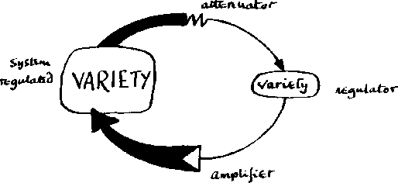
Information in VSM
Ashby’s law: only information can absorb information.
So each side of an information exchange must have the same amount of information, the same variety.

Slide 28
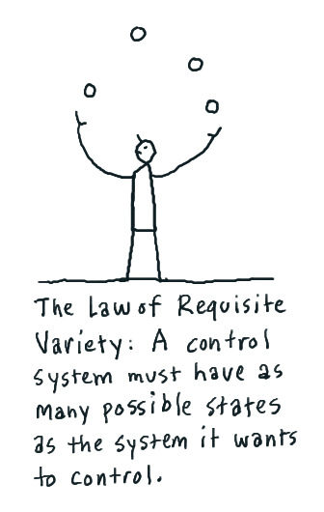
Ashby’s Law of Requisite Variety

Slide 29
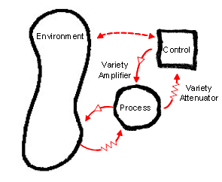
Some characteristics
The VSM and information homeostasis.
Donella meadow’s bathtub analogy.
Atenuator, Amplifier, Tranducer, Decision

Slide 30
Proof?
Lack of independent study
Many case studies showing success of VSM
Can serve as diagnostic tool too.

Slide 31
READING
Stafford Beer
Patrick Hoverstadt
Markus Schwaninger
Edmund Malik
Raul Espejo
Patrick Lambertz

Slide 32
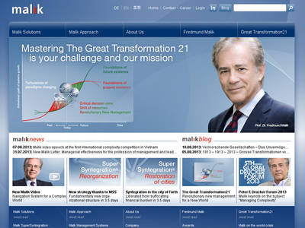
Studies
Malik School of Management, St. Gallen University, Switzerland

