Slide 1
Foresight Synergy Network
Turning an Idea into Reality in the 21st Century
by
Peter MacKinnon & Peter Chapman
Independent Researchers & Business Advisors
Email: mackinnon.peter@gmail.com & peter.chapman2@sympatico.ca
Telfer School of Management
University of Ottawa
December 16, 2016

Slide 2
Themes for discussion
Then versus Now
Managing Ideas in a Technical Business
Research, Development, Invention & Innovation
Disruptive Technologies & Innovations
Changing Business Models
R&D to Create Product
Thoughts in Closing

Slide 3
Then - 20th Century versus Now - 21st Century e.g., what has changed in manufacturing
Industry creates products and sells the same product over a lifetime (e.g., 20 years)
Manufacturing costs dominated by labour
Room for many competitors
  Penetration can be limited by manufacturing and distribution capacity
Innovative ideas considered a threat
Products are typically tangible
Industry creates products and sells the same product for 2 years
Manufacturing costs dominated by capital depreciation
Room for no competitors
  One manufacturer can flood the world due to massive, cheap mass production
Need lots of innovative ideas
Products are often soft
Additive manufacturing & the 4th Industrial Age
PC

Slide 4
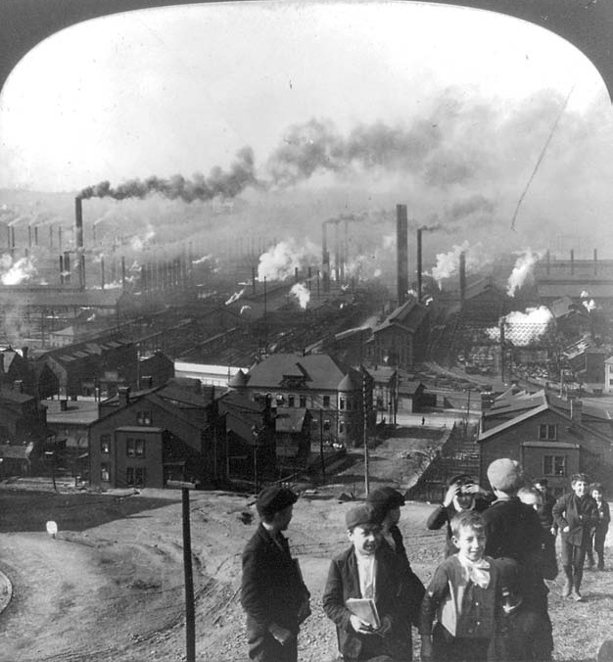
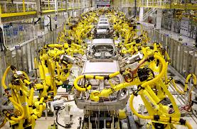
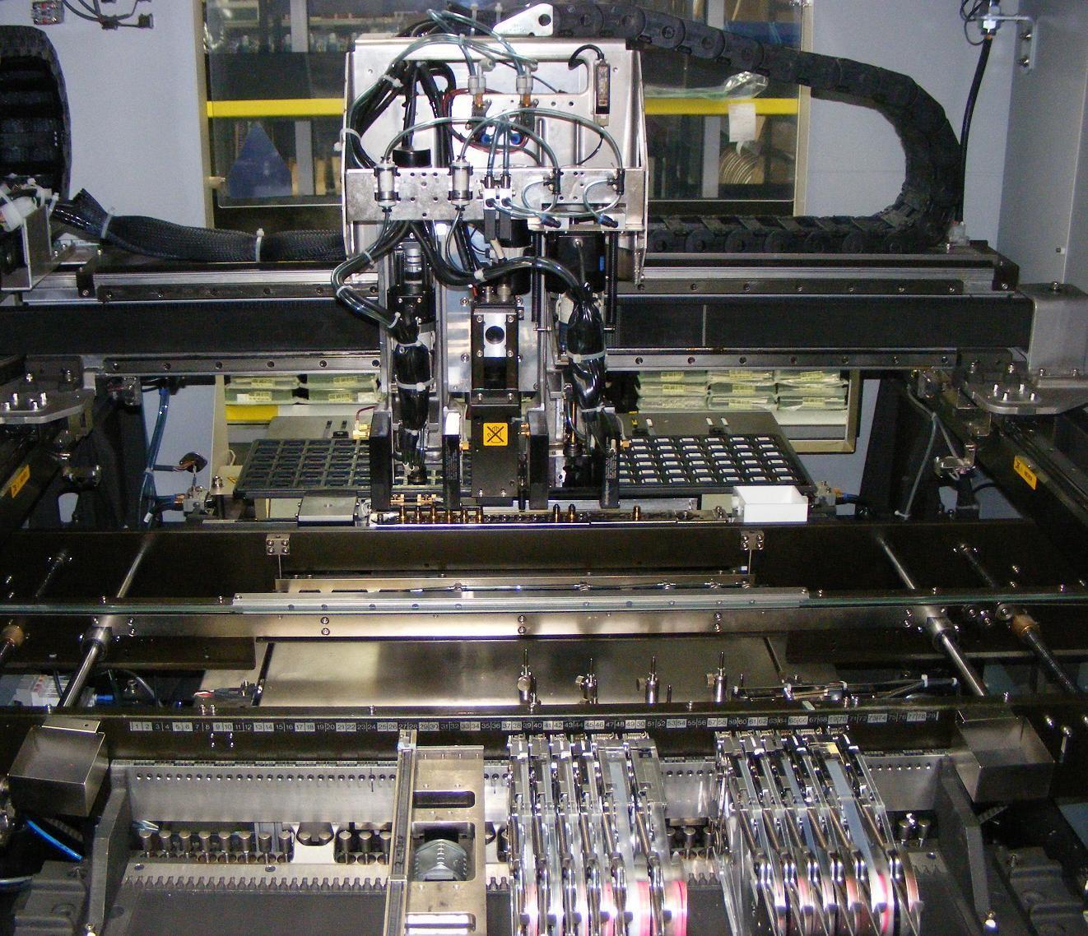
How we make things then now

Slide 5
What has changed?
Globalization
Automation in manufacturing
  Robots, pick and place machines etc.
Semiconductors
  Ability to print massive logic circuits in volume production at very low cost
Software/firmware
Internet-empowered collaboration
Emergence of autonomous systems
Content rich broadband wireless communications

Slide 6

Managing ideas
PM

Slide 7
Where do ideas come from?
Often not the most obvious
Strowger, a funeral director, created the automatic telephone switch because his competitor’s sister ran the telephone exchange
Printed circuit technology was created to deal with a skills shortage in building radios using a chassis and wire
The cavity magnetron was created for WWII radar, subsequently used in microwave ovens – ‘swords to ploughshares’
Washing machines, dishwashers, vacuum cleaners, created to remove household chores - the need drove the ideas
The steam engine was created to pump water out of coal mines
  The railway locomotive and steamships then changed transportation forever
Piped gas was originally introduced to facilitate street lighting

Slide 8

Research: what is it?
Research is defined as the creation of new knowledge and/or the use of existing knowledge in a new and creative way so as to generate new concepts, methodologies and understandings
This could include synthesis and analysis of previous research to the extent that it leads to new and creative outcomes
Research is classified into 3 broad categories of which the latter 2 are relevant to companies and product developers: basic, applied, and experimental development
Source: OECD Frascati Manual, 2002

Slide 9
Research management
Sets research goals and objectives on a project basis
Assembles and manages a team of ‘smart creatives’
Lead for technology choices and selection
Tracks, monitors and manages the technology development lifecycle
Research Managers liaise with PLMs and PMs as part of their teams by taking directions from them regarding product functionality and user feedback

Slide 10
Research management (2)
Tracks and evaluates performance against goals and objectives by defining targets and tracking research progress over time, while adjusting schedules and resources to meet changing needs
Includes all administrative and operational functions dealing with the management of research
It can include functions related to Intellectual Property protection and filing, business development and related technology transfer in the event of partnerships

Slide 11

Invention versus innovation: what is the difference?
Invention is a novel idea or concept that is unlikely to be thought of by someone else
  Often it is something that can be touched – but not always
The patent process refers to ‘invention’
  Which it defines as a novel way of doing something that would not be obvious to someone skilled in the art
Innovation is a way of doing something new
  Many business processes involve innovation
  Innovation is not necessarily more efficient or reduces effort or costs
  Many apps are not innovations
Not all innovations are ethical and socially beneficial
  Autonomous weapons
  Cloning of humans
PC

Slide 12

Why do we need invention?
The definition of invention embodies the essence of planned and serendipitous discovery without necessarily implying a specific need

Slide 13
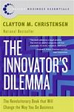
Why do we need innovation?
“Precisely because these [sic] firms listened to their customers, invested aggressively in technologies that would provide their customers more and better products of the sort they wanted, and because they carefully studied market trends and systematically allocated investment capital to innovations that promised the best returns, they lost their positions of leadership.”
Clayton Christensen: “The innovator’s Dilemma” 1997

Slide 14
Why is innovation important?
Innovation is a means of creating new sources of value and wealth
  The world economy is restructuring
  Opportunities are enormous
Innovations often disrupt traditional business models
  Online shopping, tickets, hotel booking
  Social media replacing print media
  Real-time TV being replaced by on demand streaming
Innovation often finds a new way of using an invention
  Internet was originally conceived and designed as a means of file sharing between research facilities
  WWW (Domain name servers) was the innovation that triggered its success

Slide 15
The innovation process: identify the customer’s problem - not their needs nor wants
20% of products succeed and these are the ones that address the problem rather than the stated desire or need (Clayton Christensen)
Henry Ford’s customer wanted a faster horse, but the problem was to get from one place to another more quickly, so he gave them a car
The personal computer solved the problem, not of cheap computing, because it was considerably more expensive than shared central resource. The problem it solved was detaching from a corporate resource

Slide 16

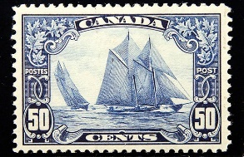
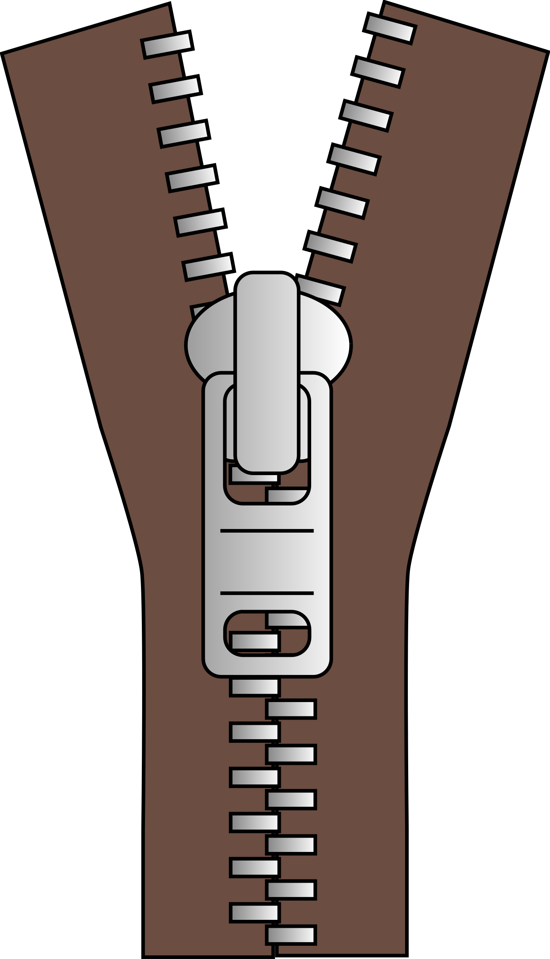
Examples of successful innovations
Pioneered a new business model for courier services that did not involve any invention; rather it is an innovation
The postage system is an innovation (1834)
  Same rate irrespective of distance
  Only sender pays – even if receiver refuses package
A zipper is an invention, and its use in clothing is an innovation
  It was originally conceived as a convenient way of closing leather boots
  Adopting it for clothing was the innovation

Slide 17
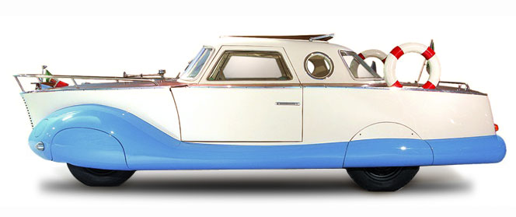

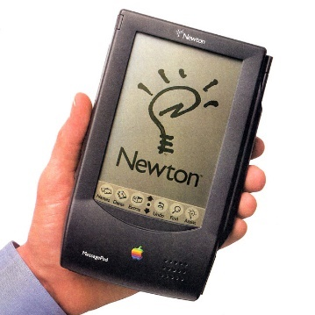
Innovations that failed
Aquatic cars
Apple Newton
Supersonic transport
Notes:
Alternative keyboards have not displaced QWERTY
Because their is too much invested skill
Reverse Polish notation, an alternative calculator input sequence, was invented to ease design of calculators
It made them more difficult to use
Apple Newton
The first PDA. Palm pilot subsequently succeeded.
ISDN – The first Internet architecture
World wasn't ready - needed www for explosive growth
DSL provided much greater throughput but at much shorter range.
Supersonic flight
Too small, and economic and political bullying.

Slide 18
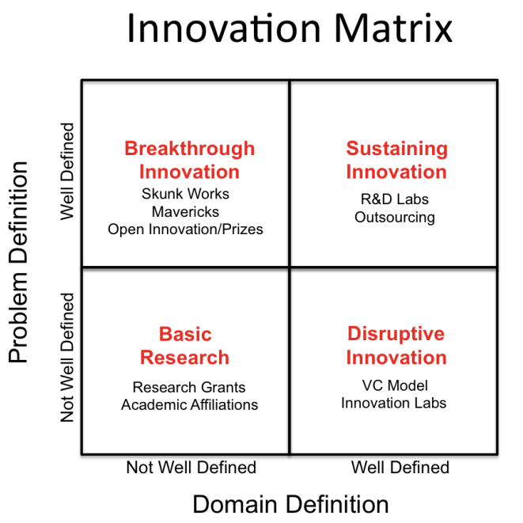
A tool for mapping innovation

Slide 19
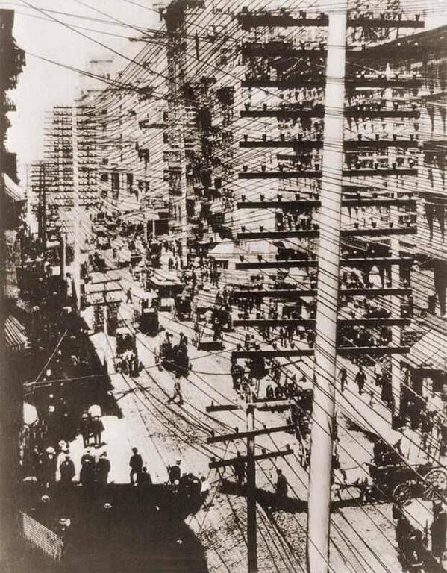
Disruptive technologies & innovations
Telephone lines in New York 1887
PM

Slide 20
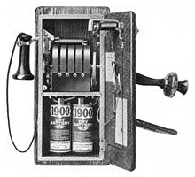

Disruptive innovations arise from disruptive technologies
Circa 2009 smartphone link to wireless on demand transportation
Circa 1900 wall phone to call operator to place a call

Slide 21
Disruptive innovation
Creates a new market and value network and eventually disrupts an existing market and value network, displacing established market leaders and alliances
  The term was defined and phenomenon analyzed by Clayton Christensen in 1995^{[1]}
  More recent sources also include “significant societal impact” as an aspect of disruptive innovation^{[2]}
¹ Bower, Joseph L. & Christensen, Clayton M. (1995)
² Assink, Marnix, "Inhibitors of disruptive innovation capability: a conceptual model."
European Journal of Innovation Management 9.2 (2006): 215-233

Slide 22
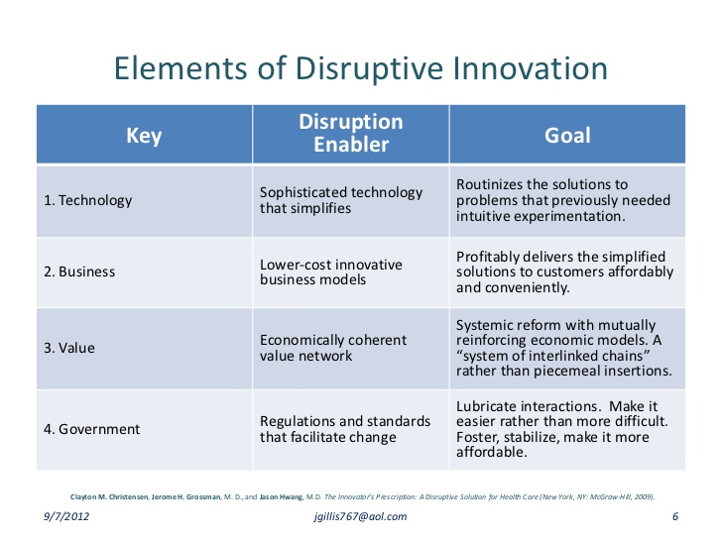
Elements of disruptive innovation

Slide 23
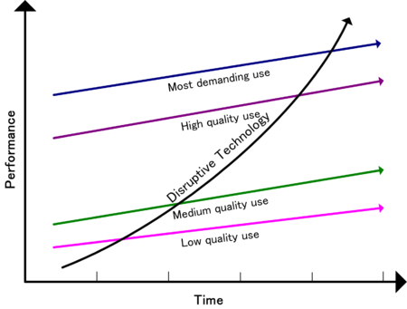
Out of the blue

Slide 24
Examples of combinations of disruptive technologies
Virtual reality
  For explanations and news see – The Virtual Reality Society at: www.vrs.org.uk
Automation of the knowledge worker
  Listen to “Replacing the Professionals” on ‘Ideas’, CBC Radio 1, April 20th at: www.cbc.ca/radio/ideas/replacing-the-professionals-richard-susskind-1.3542846
Additive manufacturing (i.e., 3-D printing)
  The printed world – see The Economist at: www.economist.com/node/18114221

Slide 25
Emerging disruptive technologies
Machine learning
  Natural language processing – see here for more info: https://en.wikipedia.org/wiki/Natural_language_processing
Big data analytics
  See - Big Data: The Management Revolution in Harvard Business Review at: https://hbr.org/2012/10/big-data-the-management-revolution
Blockchain
  Blockchain starts transition from hype to everyday use in markets as exchanges and start-ups are making their first moves to implement the technology - Financial Times (London) October 11, 2016 at: www.ft.com/world/uk
Notes:
Fundamentally, blockchain technology is enabling change of the infrastructure on which our modern economy is built. Join this session to learn how Blockchain will significantly impact the very basis of how your business is structured and services are delivered. Its impact will be at least as great as the introduction of the Internet in the 1990s.

Slide 26
The march of disruptive innovations
Disruptive Innovation | Market Disrupted by Innovation
Telephony | Telegraphy
Automobiles | Rail & workhorses
Personal computers | Mini computers, workstations & word processors
Smartphones | Plan Old Telephone
Digital calculators | Mechanical calculators
USBs & flash drives | Floppy disks
Disruptive Innovation | Market Disrupted by Innovation
Light emitting diodes | Lightbulbs
Hydraulic excavators | Cable-operated excavators
Plastics | Metal, wood, glass, etc.
Ultrasound | X-ray imaging
Digital media | CDs, DVDs, etc.
Digital photography | Film-based photography

Slide 27
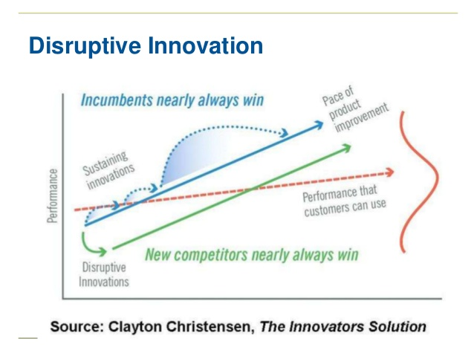
Disruptive innovation (2)
PC

Slide 28
Disruptive innovations (3)
Tend to be produced by outsiders
The business environment of market leaders does not allow them to pursue disruption when they first arise
  Why, because they are not profitable enough at first and because their development can take scarce resources away from sustaining innovations
A disruptive process can take longer to develop than by the conventional approach and the risk associated to it is higher than more incremental or evolutionary forms of innovations
  Once it is deployed in the market, it achieves a much faster penetration and higher degree of impact on the established markets

Slide 29

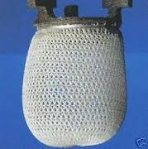
The battle lines: incumbents fight disruptors
The gas lighting industry commissioned and introduced the gas mantle, a more efficient gas light source, after the invention of the electric light bulb
Vacuum tube manufacturers did not succeed with transistors (except RCA and Phillips)
Kodak responded to digital photography, by launching the first digital camera – but failed to hold the market

Slide 30
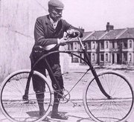
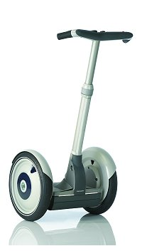

Examples of unlikely ideas that worked
The bicycle (1816 no pedals, 1885 modern)
  After it was invented people did not believe it was possible without actually seeing one
The Segway
  An unlikely idea
    It achieved only limited acceptability because it did not consider the regulations - in many territories it has to be licensed as a motor vehicle
Heavier than air flight – gliders (1853) preceded powered aircraft (1903)
  It is likely that it would not have been invented without having seen birds and insects, as it just seems so unlikely

Slide 31
Innovation is an unintended sinkhole – but you have to do it!
“Half the money I spend on advertising is wasted, the problem is I don’t know which half”
John Wannamaker, a pioneer in American retail
Similarly, more than half the money companies invest in innovation is wasted, but you have to spend it, and you don’t know which half will win in the market
In other words, there will be failure and you do not know where, why or how until it happens
An Example: Nortel
  At Nortel, the few innovations that succeeded were so successful, they more than justified the cost of those that were not commercialized

Slide 32

Generating & managing product ideas

Slide 33
Generating & managing product ideas
Leveraging internal resources for idea generation
  Create a repository of ideas, generated from across the organization, including problems addressed, features, use cases and authors
  Develop a straightforward methodology to evaluate ideas
  Rank ideas based on customer need and probability of commercial success
  Estimate resources required for initial prototyping and minimum viable product
  Create a feedback loop for ideas that pass the initial screening. Keep the originator informed and provide him or her the opportunity to stay involved with the idea as it advances through the testing and development phases

Slide 34
Generating & managing product ideas (2)
Rapid Prototyping
  This involves instituting processes to quickly convert ideas, even if they are only 25-50% complete, into live products that can be placed in the hands of testers and potential users
  Benefits include lower cost and lower risk for testing product viability and bringing products and services to market
  Requires robust and flexible product development expertise
  Also requires expedited development capabilities

Slide 35
Generating & managing product ideas (3)
Corporate Labs
Many firms, particularly large companies, have developed internal “labs” to generate new product ideas and bring these products to market
These labs have several objectives, including:
  Develop a platform and methodology for new idea generation
  Create internal awareness of the company’s quest for new products
Establish a vehicle for internal product development and validation
Create a platform to interface with third party developers and partners
Signal to the market that the organization is interested in external partnering and collaboration
Identify potential partners and/or acquisition targets

Slide 36
Generating & managing product ideas (4)
Efficient mechanisms for getting products from the idea phase to initial prototype and then to market have significant benefits:
  Quicker idea validation
  The product development cycle begins much sooner and the time to validation is shortened
    This enables the PLMs to arrive at a ‘go/no go’ product decisions within weeks rather than quarters or more
    This approach allows for a cheaper and lower risk idea evaluation versus a full blown product development approach in isolation
Create an increased sense of reward for the idea generators, fostering a culture of innovation for the company as a whole

Slide 37
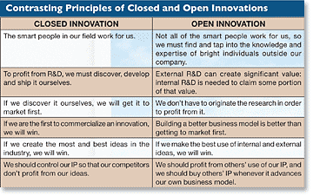
Contrasting principles of closed & open innovation

Slide 38
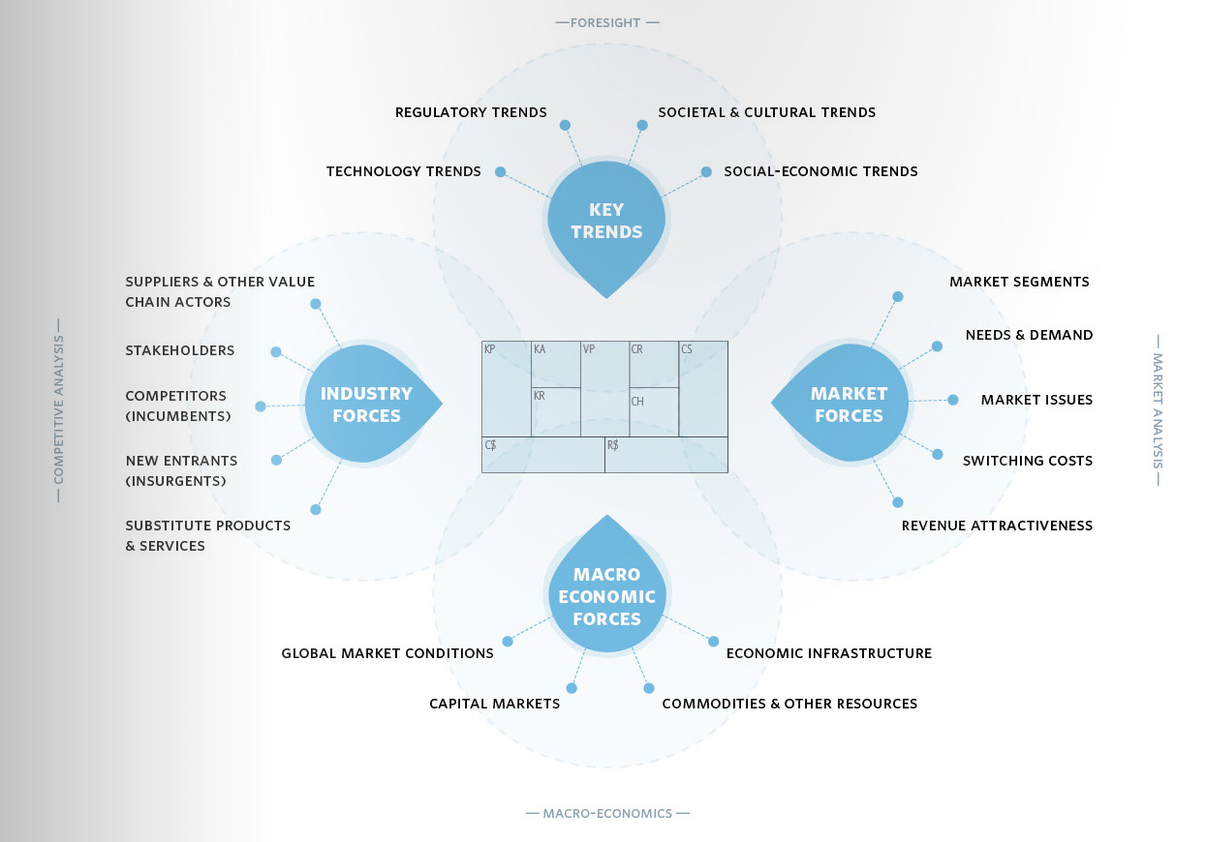
Changing business models
PM

Slide 39
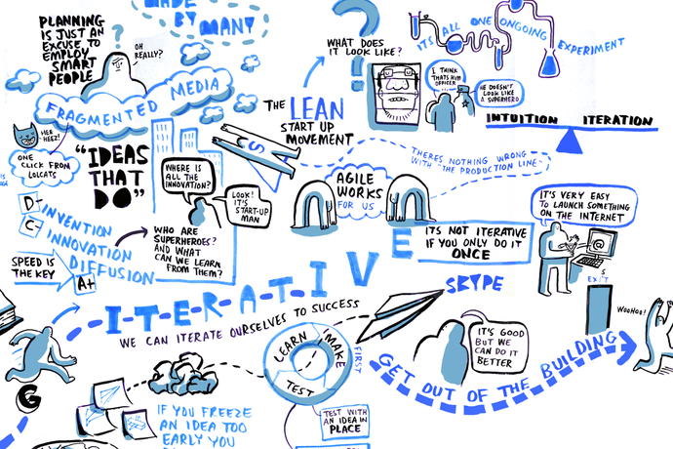
In a picture – here is what we are going to talk about

Slide 40
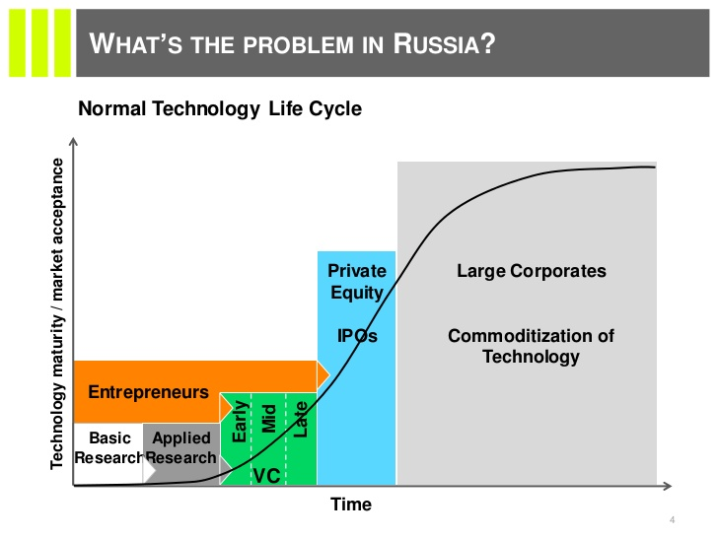
Corporate scaling curve

Slide 41
Traditional model of R&D intensive businesses
External Knowledge
Research
Development
Marketing
Sales
Manufacturing
Channel Distribution
Customers

Slide 42
Model for managing innovation in the 21st Century
External Knowledge
Research
Strategic Alliances
Development
Future Markets
Marketing
Sales
Manufacturing
Channel Distribution
Customers
Arrows represent the flow of information, the thickness of the lines represents the volume of information flowing in the system, and here marketing represents the central hub of the business

Slide 43
Pipes versus platforms
Pipes are the traditional business model and they are characterized by companies producing goods and/or services and selling them in target markets
  (e.g., firms create stuff, push them out and sell them to customers)
  Value is produced upstream and consumed downstream
  There is a linear flow much like water flowing through a pipe
Platforms do not just create and push stuff out, they allow users to create and consume value beyond Pipe-based products
  This is a business model never seen before and is a direct consequence of the availability and richness in content and tools on the internet

Slide 44
Pipes versus platforms (2)
At the technology layer, external developers can extend platform functionality using APIs
  This can lead to new functionality, enhanced performance, new products and add-ons
At the business layer, users (Producers) can create value on the platform for other users (Consumers) to consume
  By example, TV Channels work on a Pipe model whereas YouTube works on a Platform model
  Amazon is a Platform whereas a bookstore is a Pipe
  Encyclopedia Britannica works on a Pipe model whereas Wikipedia has built value on a Platform model

Slide 45
So why is the distinction between these models important?
Platforms are a fundamentally different and an innovative business model
  If you go about building a Platform the way you would build a Pipe, you are probably setting yourself up for failure
We have been building Pipes for the last few centuries and we often tend to bring over that execution model to building Platforms
  For example, the media industry is struggling to come to terms with the fact that their business model has shifted
  Traditional retail, a Pipe, is being disrupted by the rise of online marketplaces and in-store technology, which work on the Platform model

Slide 46
Product design and management
How this is accomplished depends on whether one is dealing with a Pipe or a Platform business model
Creating a Pipe requires one to build with the Consumer in mind
  Example, an airline like Air Canada is a Pipe that allows users to consume airline tickets
    The features on the companies website are built with a view to enable consumers to find and consume airline tickets
In contrast, a Platform requires one to build with both Producers and Consumers in mind
  By contrast to the Air Canada model, Expedia on the other hand is a Platform offering a range of travel services mostly provided by others who leverage economic value out of the Platform
  Building YouTube, Dribbble or AirBnB requires one to build tools for Producers (e.g., video hosting on YouTube) as well as for Consumers (e.g., video viewing, voting, etc.)
  Keeping two separate lenses helps one build out the ‘right’ features

Slide 47

PC

Slide 48
Smart creatives
“Smart creatives” is the Google term for those talented individuals that make a major difference to a company
They are the “action people” who create new things
A culture for encouraging product and service ideas is critical to the future of an organization
Most companies do not do the culture thing well
Smart creatives are at the core of successful companies
A strong corporate culture is key to attracting smart creatives
For example:
  Microsoft has identified about 300 smart creatives, and they know who they are
  Hewlett Packard, before they became a “me too” company, had a smart creative culture
  Apple formally recognizes smart creatives

Slide 49
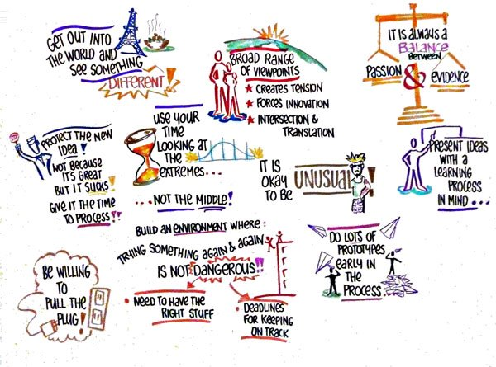
The world of smart creatives

Slide 50
Smart creatives: an example
BNR was a hotbed of smart creatives who gave us the digital world, fibre transmission, digital switching, high speed access, high capacity routing
They gave us the infrastructure for the Internet
When executive management decided smart creatives were costing, with no immediate, identifiable revenue resulting, they killed the culture
  They called it “R and D efficiency”
They believed all smart creatives, became start ups
Smart creatives are the lifeblood of the company
  Kill the smart creative culture and you lose the future
People buy from companies with a futures culture

Slide 51
21st Century modus operandi
Recruit & foster “smart creatives”
Focus on users and know your customers (e.g., who pays and who uses)
  - but don’t listen to them too closely
Think big
  - go beyond the ‘me too’ and not ‘just another app’
Set strategic goals
  - try to make them almost unattainable
Ideas come from anywhere
  - employees, customers, partners, competitors & universities
Ship and iterate
  - agile development & work with partners
Fail well
  - do it fast & without recrimination

Slide 52

21st Century modus operandi (2)
Understand your context by:
  addressing a big challenge or opportunity
  creating product that is significantly different from the competition
  ensuring the technical solution proposed is feasible
  fostering a collaborative working environment
  hiring the best talent possible using a team approach
  asking the hardest relevant questions
    (e.g., why are we doing it that way?)
Source: How Google Works, E. Schmidt & J. Rosenberg, 2014

Slide 53
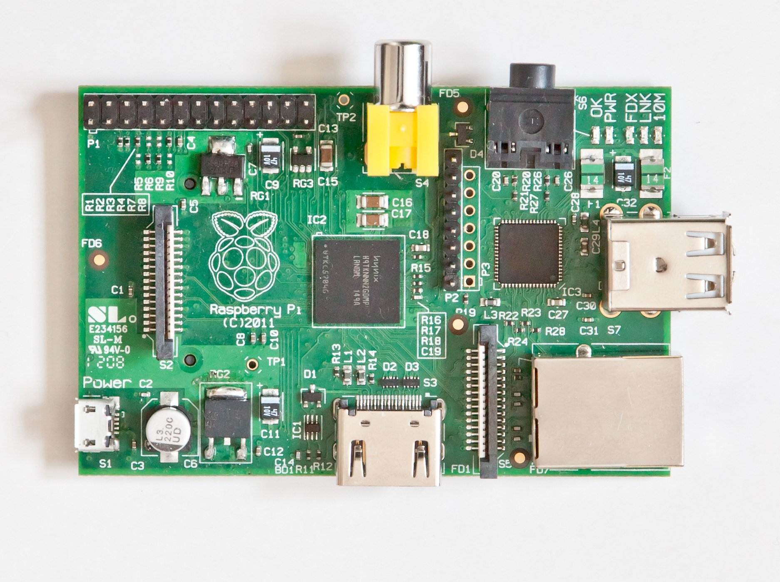
Raspberry pi
Guess where it is made…
Guess what it can do (if you don’t already know) . . .

Slide 54
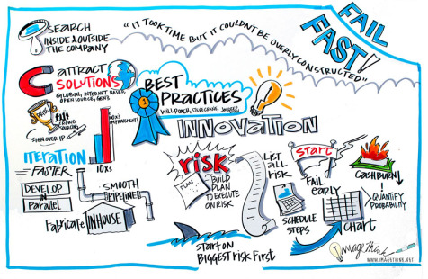
In Summary
PM

Slide 55
Thoughts & Observations
Turning creative ideas into products is central to creating wealth
A key challenge in many companies is getting management time & commitment to new ideas and product directions
“Smart creatives” are the agents of change for new ideas and product directions
The rate of change in invention, innovation and changing ways to manage R&D is accelerating over rates of the past
Invention and innovation are often misunderstood
  (e.g., especially publicly funded ‘innovation’ programs)
Disruption is the “new norm” in business
Research management is a tricky business involving a mix of many things from selecting the right idea to ensuring “smart creatives” are happy campers, while watching out for and dealing with disruptors
A new kind of business model has emerged that embraces much of the changes discussed here

Slide 56

Thanks – Merci
Any Questions or Comments?

Slide 57
Support Slides

Slide 58
Innovation Culture in Canada
Nortel/Bell Northern Research
  Identified and created many new products and services that made the Internet possible (e.g., digital networks & optical transmission)
Blackberry
  Changed the game in phones from basic to smartphone (e.g., created the ‘keyboard on a phone’ concept)
Wesley Clover
  A high tech ideas incubation company created by Terry Matthews (e.g., founder of Mitel and Newbridge)
Medical technologies
  Canada identified and enabled the production of insulin
  Canada created the vaccine to protect against polio
  John Bell of the Ottawa hospital, has identified and is developing viruses that cure cancer
These organizations all have or had a management culture that recognized valued and rewarded innovation

Slide 59
