Slide 1
Cardwell’s Law & Canadian Innovation
Solution to the Canadian Paradox?

Slide 2
Cardwell’s Law
Cardwell’s Law (as cited by Joel Mokyr (1990) The Lever of Riches (Oxford))=“No nation has been technologically very creative for more than an historically short period”. (207—and 5 further references), (in reality “a crude empirical reality”). plus Mokyr (1994) Research Policy article)
Explanation: in single countries, innovation evolves to the point that an innovation-absorbing barrier to technological progress emerges. (M, 1994) BUT inter-state rivalry in Europe ensured that innovation continued somewhere –”Cardwell’s Law and the political economy of technological progress”.
What do we make of this? (1) That ultimately markets and institutions develop endogenous barriers to further innovation—i.e. manifest asymptotic behaviour and (2) governments (sometimes) succeed in unblocking them for “raisons d’état”– typically national economic rivalry.

Slide 3
The Canadian Innovation Paradox
Canada’s S&T outranks that of many innovative countries.
Yet Canada has few if any comparative advantages in high technology products.
This after 20 years of innovation initiatives (1987-2007) and more than C$400 Billion in R&D spending (cumulative).

Slide 4
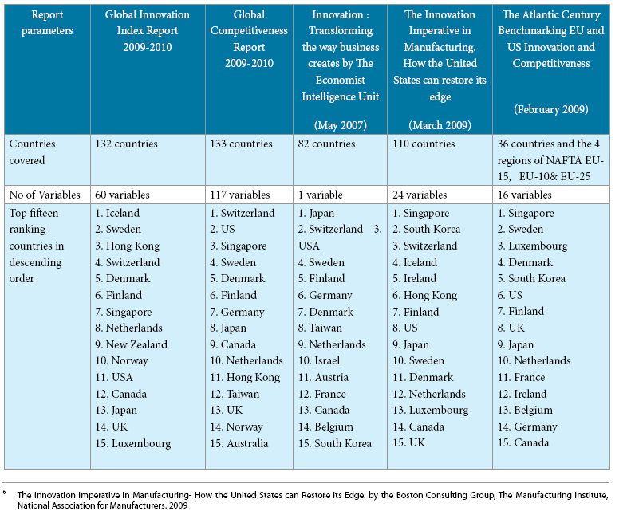
Source: INSEAD 2010

Slide 5
Table: Canada Major RCA with Rest of World (from OECD STAN Bilateral Trade Indicators 2008)
Industry | RCA
Fertilizers | 3.3
Live Animals | 4.5
Wood Pulp | 3.3
Wood & Wood Products | 5.8
Nickel | 6.8
Zinc | 3.2

Slide 6
Table: Canada –US RCA in Advanced Technology Products
Industry | Canada | US
Civil aviation | 1.47 | 4.17
Precision instruments | .03 | 1.6
Radio, TV and communication | 0.4 | 1.3
Office and computing equipment | 0.3 | 1.4
Pharmaceuticals | 0.5 | 0.96

Slide 7
Table : Innovation Rank and Selected Broad Performance Indicators (GCR 08-09)
 | Finland | Japan | Canada
Innovation Rank | 2 | 4 | 13
Quality of Scientific Institutions | 11 | 15 | 4
FDI & Tech Transfer | 22 | 36 | 7
Financial Sophistication | 18 | 48 | 6
Regulatory Burden | 12 | 9 | 40
Use of Mobile Phones | 18 | 52 | 75
Internet Use | 18 | 32 | 6
Use of PCs | 22 | 26 | 1

Slide 8
Table : Innovation Capacity Rank and Selected Business Innovation Indicators (GCR 08-09)
 | Finland | Japan | Canada
Innovation Cap Rank | 1 | 2 | 18
Company Spending on R&D (BERD) | 9 | 2 | 22
University-Industry Research Collaboration | 4 | 21 | 14
Utility Patents | 4 | 3 | 10
Firm Level Tech Absorption | 8 | 2 | 18

Slide 9
Current explanations
The explanation of choice arising from the CCA’s study last year is (principally) that Canadian business underfunds R&D and
In particular, Canadian companies are slow to adopt strategies that depend on innovation for success.
This is not really an explanation. Rather it is a restatement of the problem. Instead, we need to examine the system with a view to identifying & analyzing its endogenous barriers to innovation (Cardwell’s law).

Slide 10
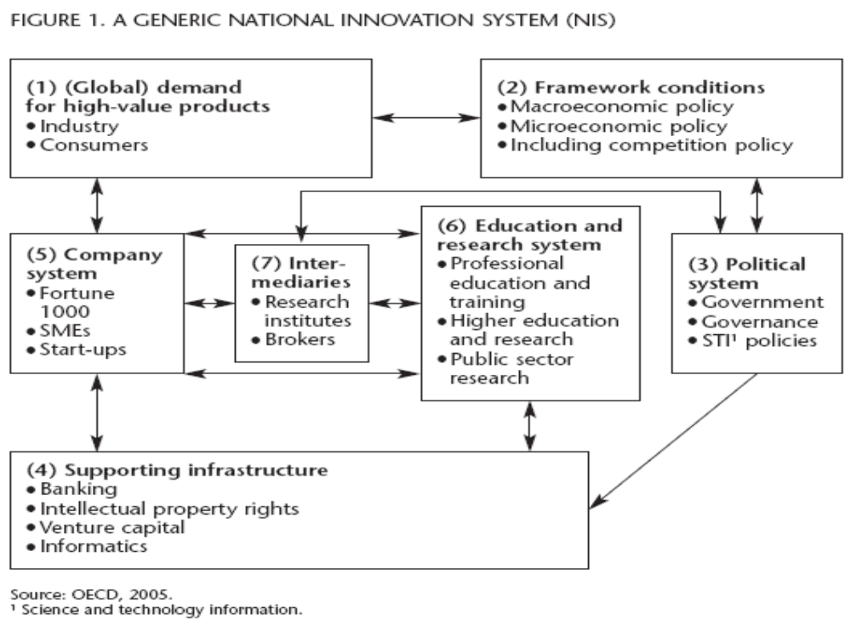

Slide 11
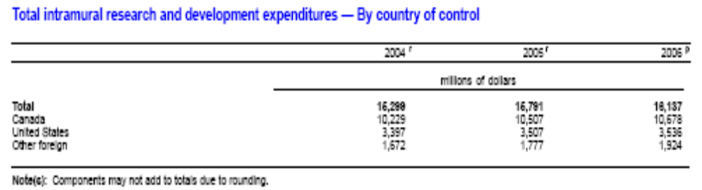
R&D Intensity by Industry production (% gross output valued at current prices )
Country | Industry | 1999 | 2000 | 2001 | 2002
Canada | Hi Tech | 10.4 | 10.1 | 11.9 | 11.0
 | ICT | 10.9 | 11.7 | 16.7 | 14.8
US | Hi Tech | 10.5 | 10.7 | 11.2 | 11.2
 | ICT | 10.3 | 11.1 | 13.9 | 12.4

Slide 12
Table: National Innovation Systems: Selected Inputs and Outputs
 | GERD (% GDP) | BERD (%GERD) | Triad Patent Families (per million pop) | Scientific Publications (per million pop) | HRST in workforce (%)
Canada | 2.02 | 46.7 | 25.4 | 783.2 | 35.6
US | 2.74 | 64.9 | 55.2 | 725.6 | 32.2
OECD | 2.41 | 62.5 | 43.9 | 573.2 (EU15) | 29.7
Question: What accounts for Canada’s low BERD multiple
—or high BERD multiple in other OECD countries?

Slide 13
Table: Selected Recent Achievements: Canadian S&T
Patents | Ranking in Core and Citing Papers (excluding US and Japan)
Matches US in RCA in ICT patents (1.03) ranking 9th place. (Finland leads with 1.66) | 3rd in environmental science
Fuel Cell Patents: Same global share as France (3.6%). Japan leads with 48.4% | 4th in regenerative medicine
Triadic Patents per million population: Ranks 19th (see table above). Japan leads with 115 | 6th in analytical chemistry

Slide 14
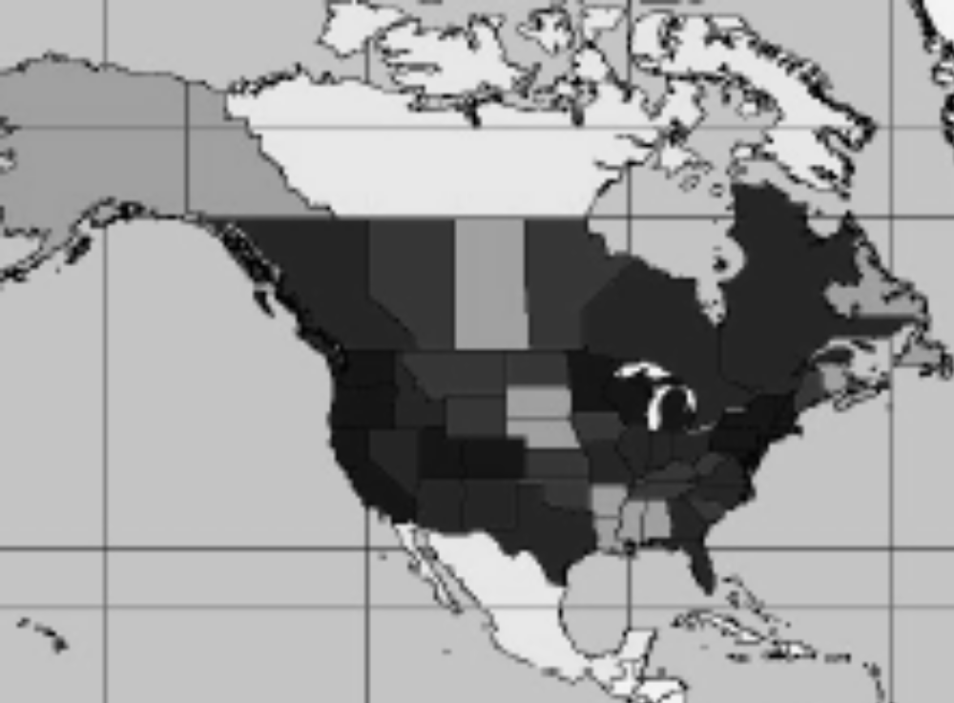
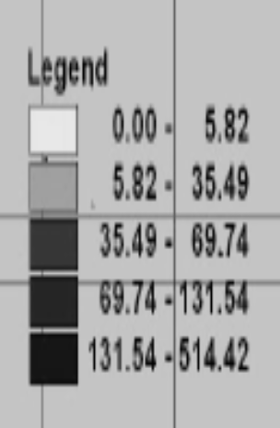
North American Innovation Geography (Patents/pop)

Slide 15
 | 1993-5 | 2003-5
Foreign Ownership of domestic invention | 24.9% | 32.9%
Domestic Invention with Foreign Co-inventors | 19.2% | 27.2%

Slide 16
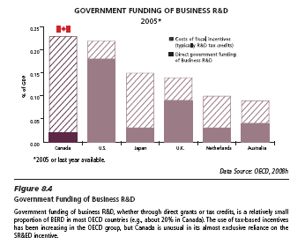
Government funding matters
Source: CCCA 2009

Slide 17
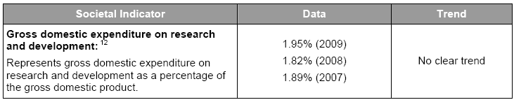
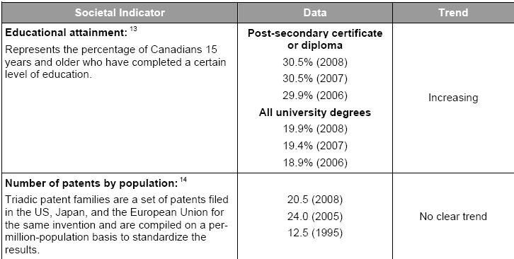
A More Current Picture—TB Report 2010

Slide 18
Canadian firms rely on US for innovation support
Foreign Ownership provides convenient access to new technologies developed outside Canada and involves the technology community heavily in local adaptation of that technology to Canadian needs.
  Statistics Canada puts US affiliate spending on R&D in Canada at 22% of Canadian BERD, noting US controlled firms received 37% of their R&D funding from outside Canada. US foreign affiliates do approximately twice the amount of R&D performed by other MNEs in Canada.(Statistics Canada 2009 Industrial R&D Intentions 2008, p.6 and table 5-4).
Canadian innovators overwhelmingly cooperate with US firms ahead of any other partner choice.
  The most recent Statistics Canada survey of innovative manufacturers in Canada shows that four times as many Canadian innovative manufacturing firms collaborate with plants in the US than with Canadian government labs, three times more than with Canadian colleges and technical institutes, twice as many as with Canadian universities. Two thirds of innovative manufacturing firms in Canada (65%) licence products from the US v. 5 per cent or less from government labs or universities (Uhrbach 2009).

Slide 19
Figure : The US in Canada’s Innovation System
Global Demand : US absorbs 66% of Canadian advanced tech products. In 2006, Canada was the top US supplier of weapons, second in aerospace and third in computer software. Canada is the 2nd largest destination for US high tech products after China, the largest for software and 3rd largest for life sciences. (US National Science Board, science & Engineering Indicators 2008, OECD Stan )
Policy Framework: (OECD STI Scoreboard 2009)
GERD (%GDP 2007)
Canada 1.9
US 2.7
OECD av. 2.3
BERD (%Industry value added 2007)
Canada 1.3%
US BERD 3.1%
OECD av. 2.4%
Company system: US Firms perform 22 % of industrial research in Canada R&D, mostly local adaption. (Stat Can)
Crossover patenting the norm: Canadians patent 3 times as much in the US as in Canada, the US patents in Canada about 3 times more than Canadians. Eight of top 10 patenting companies in Canada are US companies. (USPTO, CIPO)
Canadian Policy favours SMEs and growing industrial R&D at universities. US environment offers faster track to efficient company size.
Canadian academics coauthor with US (43% of Canadian S&E article output). US NIH a major funder of Canadian science, CIAR Funds US leading researchers.
Intermediaries: Two-thirds of Canadian hi tech firms would rather partner with US firms than with university or govt labs. (Stat Can)
IP Regime: Publicly funded research hard to transfer to private sector.
Law and practice clearer in the US (Since Baye-Dole)
Largest single source of retail investment in Canada is the US

Slide 20
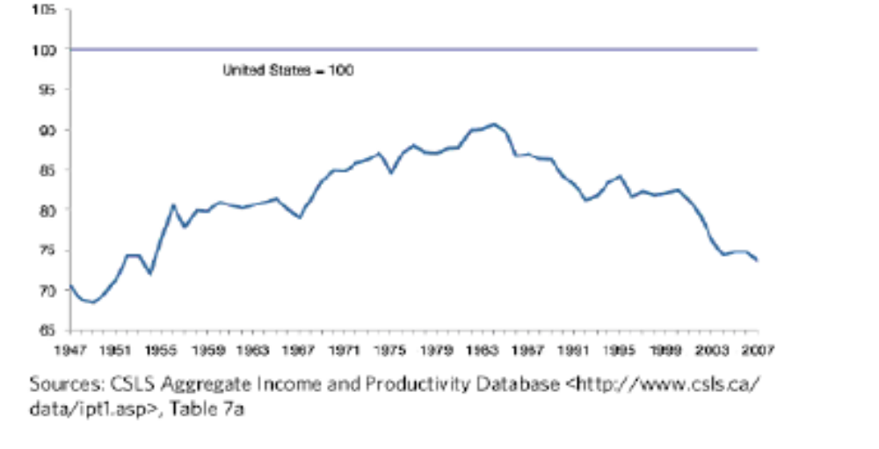
Real Output per hour Worked-Business sector
Canada as a percentage of US Level 1947-2007

Slide 21
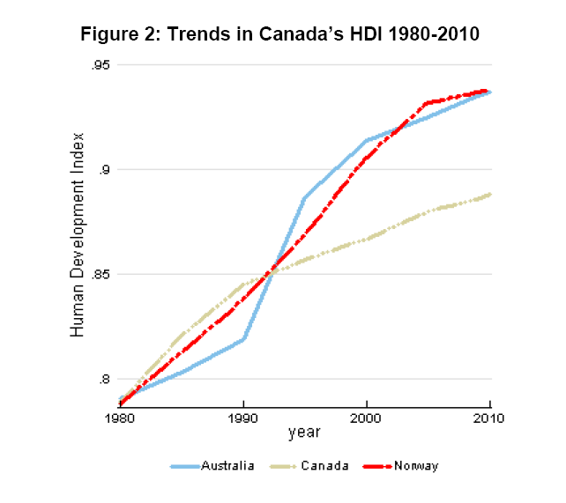

Slide 22
Endogenous Sources of Innovation Stagnation in Canada
Rybczynski’s law and the natural resource boom (expanding sector approaching a cyclical top)= sets the relative value scale of investment capital.
“Market for Lemons” structure of technology valuation in Canada.
More favourable risk-reward profile in the US—less unfavourable to innovation than Canada if only because of the larger population of innovators and supporters -- : moving to the US lowers the risk discount rate on Canadian tech (seen for example, in increased VC deal size).

Slide 23
Other endogenous barriers
Stagnation in the health care system blocks significant change, such as move to patient centred services based on technology-intensive care in smaller clinics and doctors offices.
Stagnation in Canada’s national security configuration, which is only just now beginning to open up but is way behind on tech intensity, interoperability, etc.
Technical Stagnation in other major systems (such as telecom, infrastructure, electrical grid, mining, forestry...)

Slide 24
These barriers have models
Mancur Olsen’s model of pressure group gridlock—most evident in health care;
Stackleburg competition in large industry sectors (civil aviation, media, telecom, financial services...) that might otherwise buy and deploy more technology.
The Martingale properties of innovation, which by definition converge to a stable expected value limit reflecting the composition of the innovating population—and alternative uses of resources. (Assured high returns to non-innovators)
Ease of translation with the US as alternative = the ability to find better odds than those offered the Canadian innovation martingale.
Solution= The Sovereign Power of Innovation Valuation (Cdn. innovation is a sub martingale to US innovation—hence the translation gains whereas protected industries are super Ms here).
Note: The Sovereign Power of Innovation Valuation derives from the power of government procurement to change the domestic innovation martingale—especially for as yet to be invented technologies—and thereby encourage a flow of game changing outputs. (Ex: US:-DARPA, SBIR; Other leaders have similar programs.)

Slide 25
Some Consequences for Canada’s Innovation Performance
(1) Canada’s advanced technology RCAs are weak because –apart from the below OECD average public funding--Canadian advanced technology companies are obliged by the configuration of forces to compete in or with the US system in ways that transfer their locus of competitive development to the US.
(2) Canadian companies that choose to compete on innovation are generally more involved with US and global markets than the Canadian market because those are where the value creation possibilities are greatest.
(3) Greater economic integration by Canadian technology companies with the US market would –other things equal--therefore NOT accelerate Canada’s relative innovation rate
(4) If Canada wants to improve its innovative performance and become a global technology leader, Canada will have to create a different domestic environment for its industries so that more firms which choose to innovate technologically can more easily reach efficient size in Canada. This is ultimately a matter of public policy and program design.

Slide 26
Solution: The Sovereign Power of Innovation Valuation
Government must use (inter alia) its procurement power to unblock innovation barriers in technology market structure
Key is to start or expand some companies with a mission to conquer some technology space which will be useful to government in fulfilment of its mission.
Techniques for mission selection and mobilization of support (think Finland) include significant use of foresighting, roadmaps, targeting social and economic benefits to be achieved together with an emphasis on good management.
Aim: BERD as 70-80 per cent of GERD, and attainment of RCA in at least two technology sectors every 10 years.
--//--

